Slide 1


SC-300 C.E.R.T
Microsoft Identity and Access Administrator
Mark Grimes
MCT since 1997
https://aka.ms/SC-300
https://aka.ms/YouTube/SC-300

Slide 2
Session objectives and takeaways
At the end of this session, you should be
better able to…
  Understand the exam objectives
  Learn some tips and tricks to augment your learning
  Learn some real-world stuff too!
aka.ms/SC-300

Slide 3
Using this Deck to Study…
https://aka.ms/SC-600Slides
Some slides have multiple animations
They may hide really important content!
To use this deck to study with use in “Slide Show” mode F5*
Then you will see all content AND links will work ☺
The “Click to Zoom” slide next allows you to jump to topics *

Slide 4
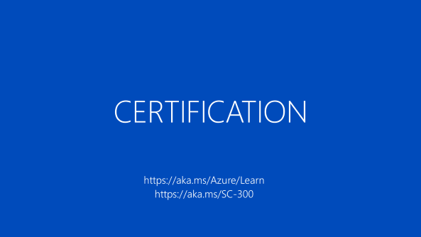
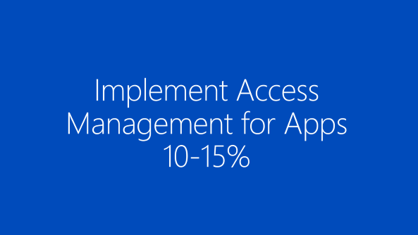
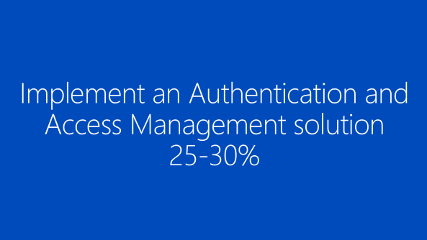
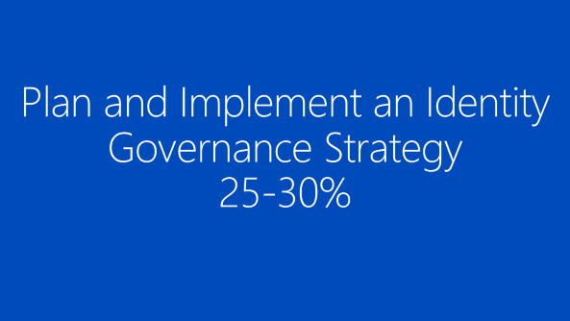
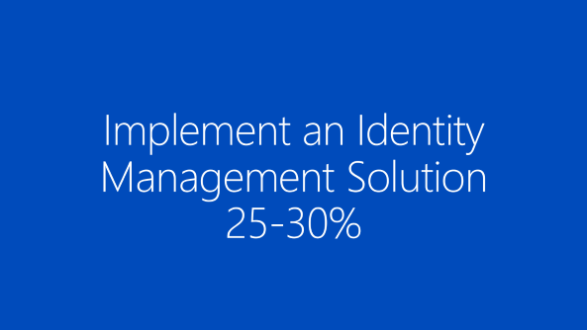
SC-300 Preparation Menu
https://aka.ms/SC-300

Slide 5
CERTIFICATION
https://aka.ms/Azure/Learn
https://aka.ms/SC-300

Slide 6


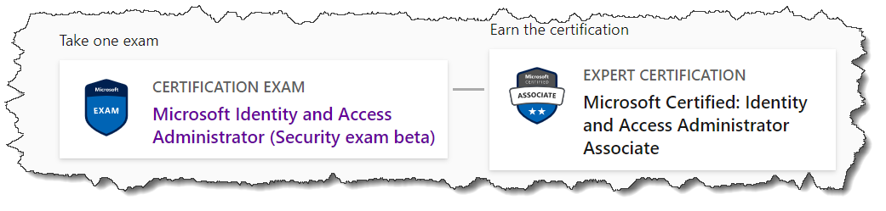
Related Certification
Identity and Access Administrator Associate
SC-300 Study Guide Charbel Nemnom
Skills Measured
    Implement an Identity Management Solution
    Implement an Authentication and Access Management solution
    Implement Access Management for Apps Manage infrastructure
    Plan and Implement an Identity Governance Strategy
aka.ms/SC-300StudyGuide *

Slide 7
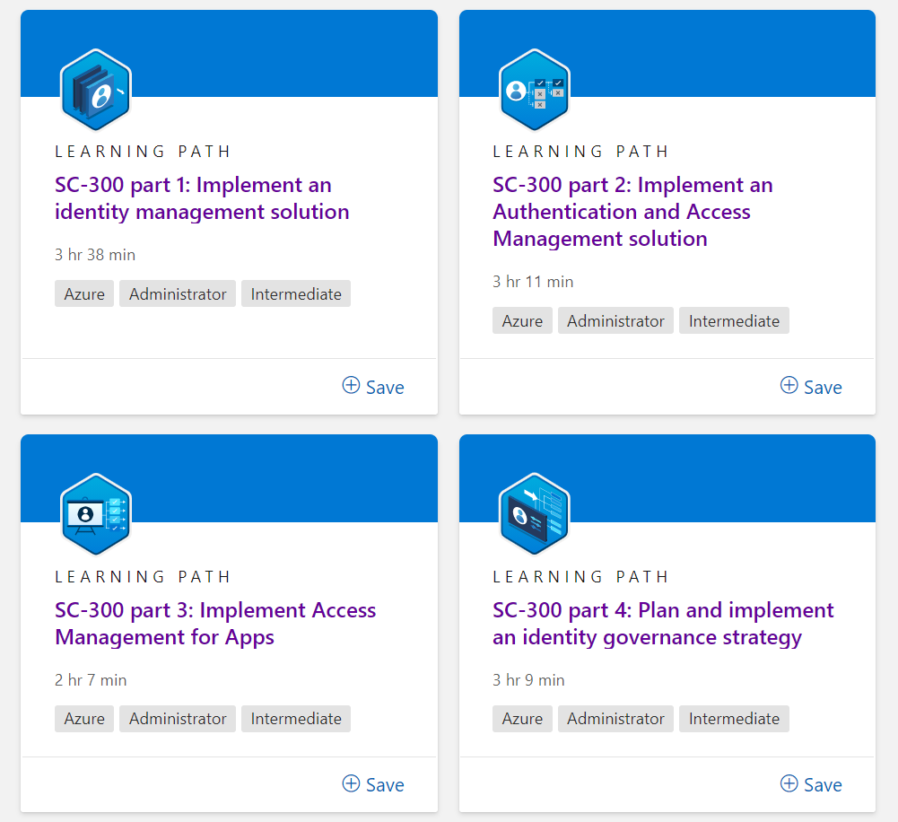

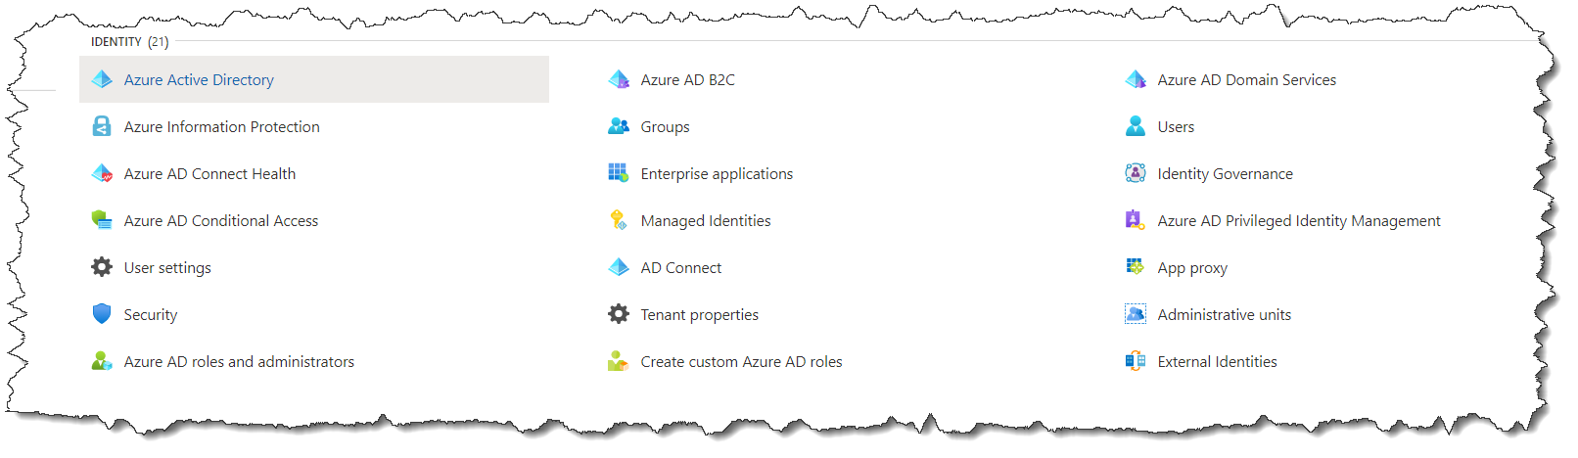
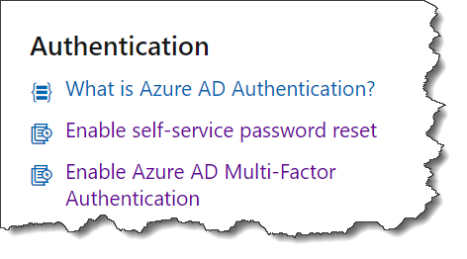
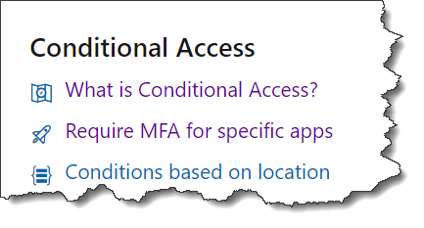
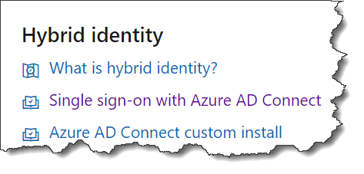
How to prepare for the exam…
Know the exam objectives!
Study the Docs related to the exam objectives
If there are practice exams, take one ..maybe soon!
Get hands on if possible?
Learning Paths for SC-300
    SC-300 part 1: Implement an identity management solution
    SC-300 part 2: Implement an Authentication and Access Management
    SC-300 part 3: Implement Access Management for Apps
    SC-300 part 4: Plan and implement an identity governance strategy
    https://aka.ms/SC-300

Slide 8
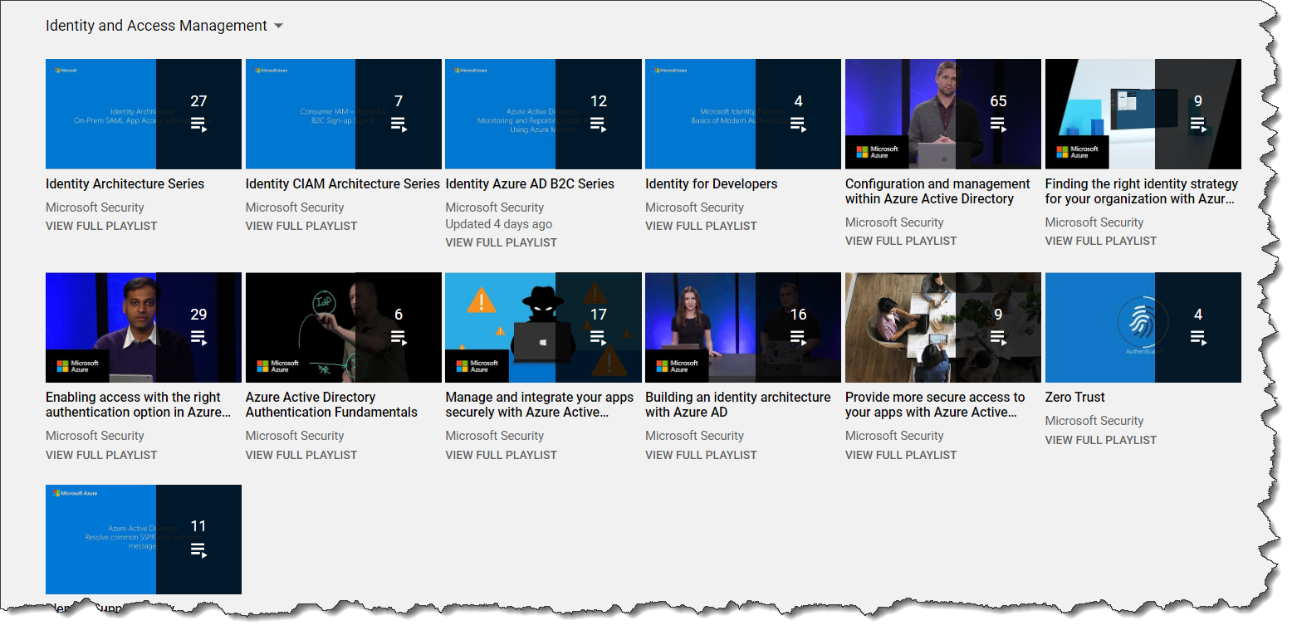
Other places to look for help
If hands-on and docs aren’t enough, try…
  http://aka.ms/IdentityYouTube – YouTube Channel!

Slide 9
Implement an Identity Management Solution
25-30%

Slide 10
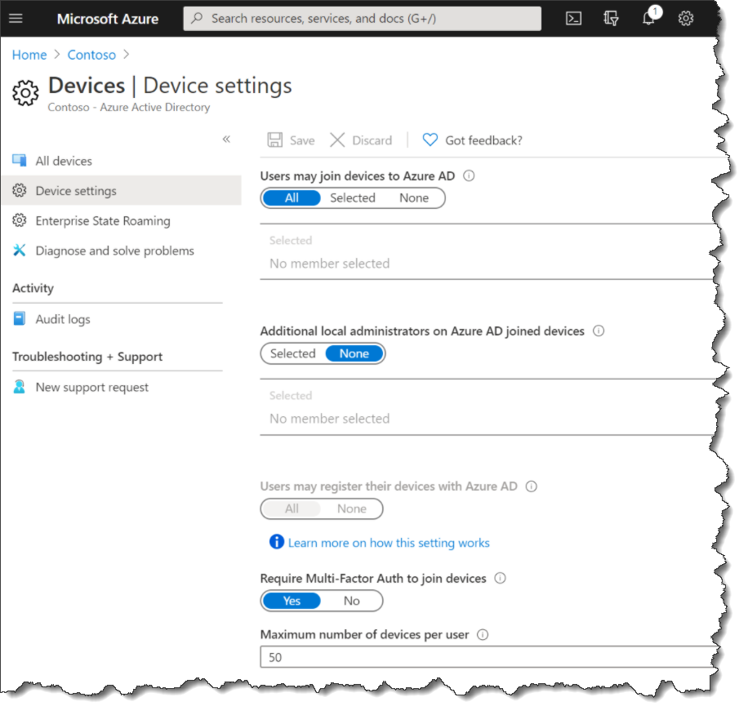
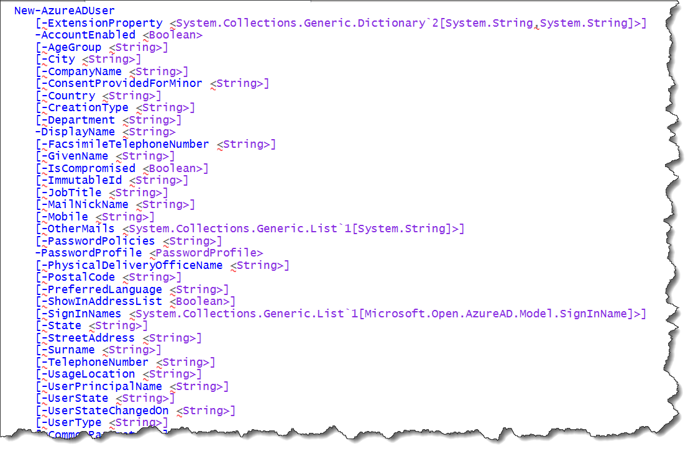
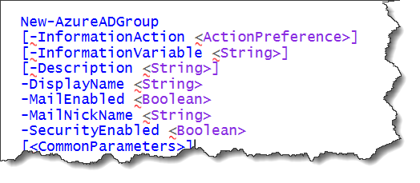
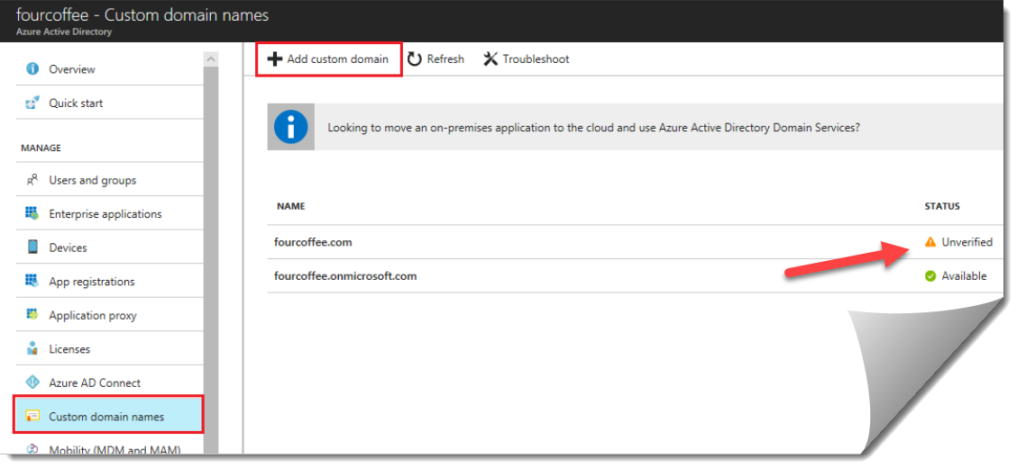
Configuration of Azure Active Directory
Azure AD Roles
    Best practices for Azure AD roles
    Built-in Roles + Custom + Limits
    Azure AD Graph
Custom Domains
    Add and verify custom domain names
    Verify subdomain
Device Registration
    How to manage devices + FAQ
    Configure Device Settings
Azure AD roles documentation

Slide 11
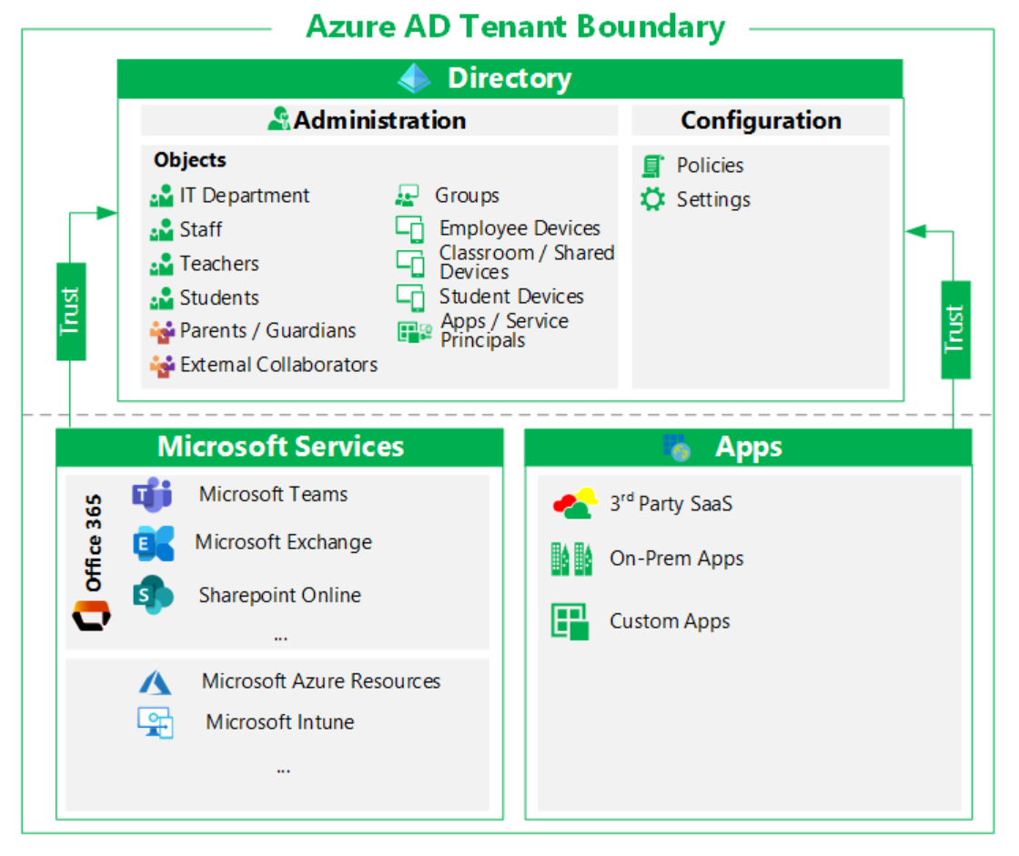
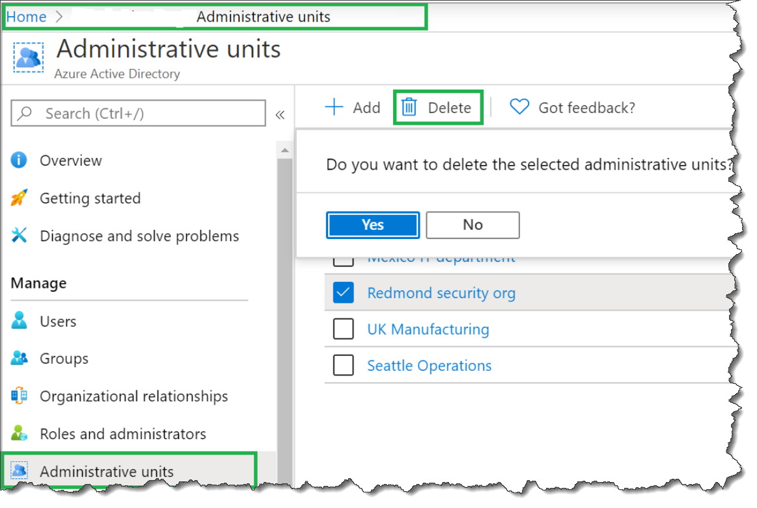
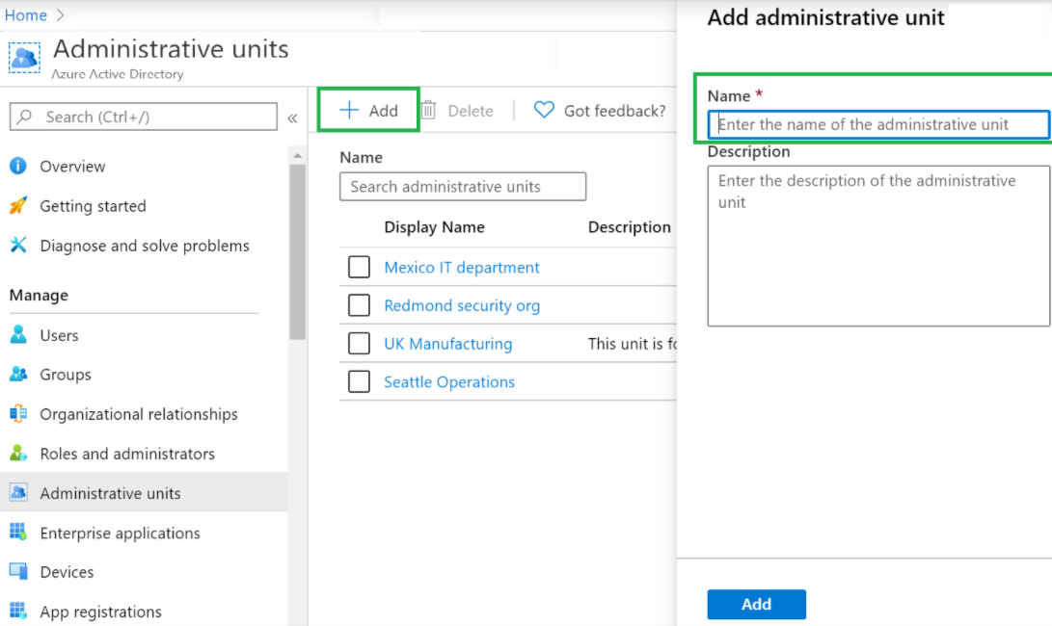

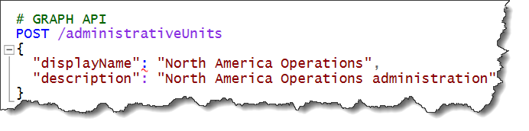
Configuration of Azure Active Directory
Delegation with Administrative Units
    Add and remove administrative units
Tenant Wide Settings
    Introduction to Azure Active Directory Tenants

Slide 12
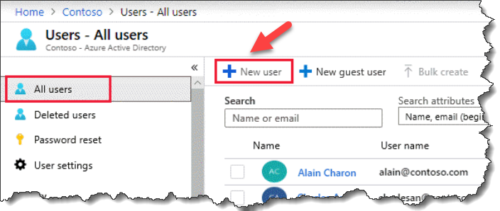
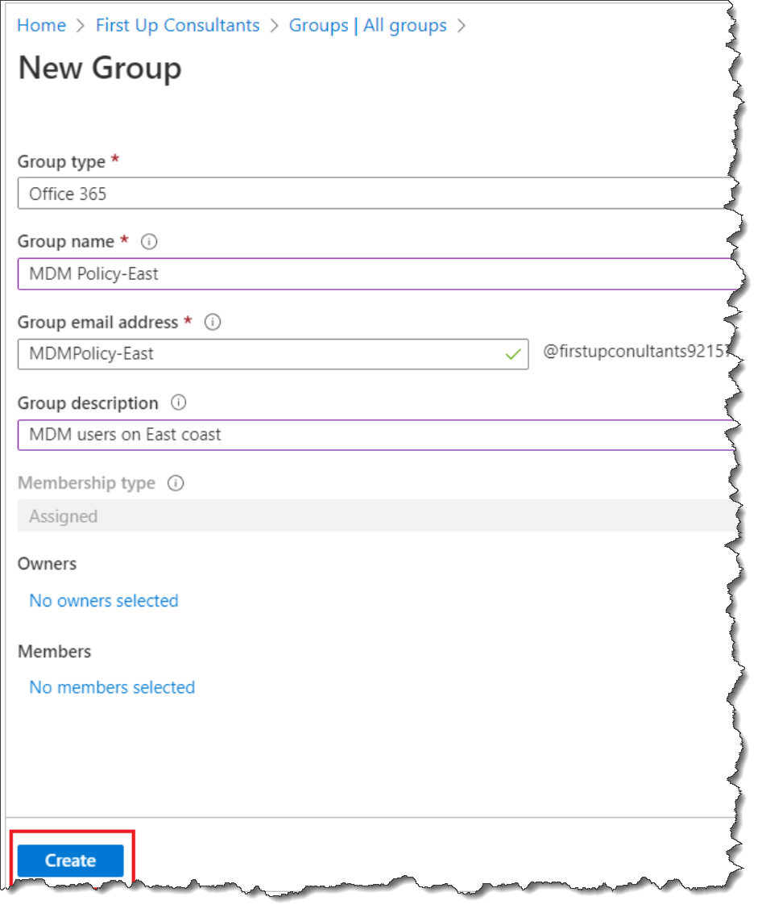
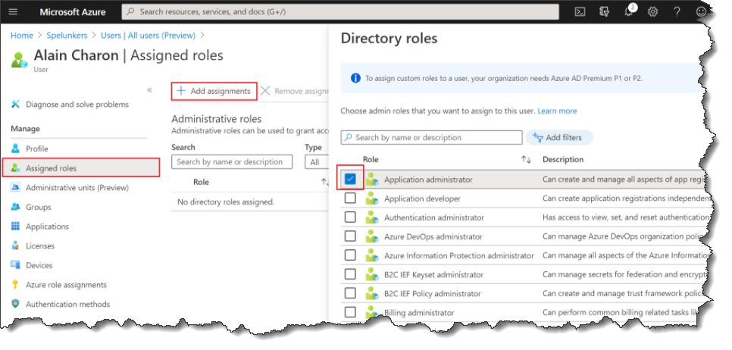
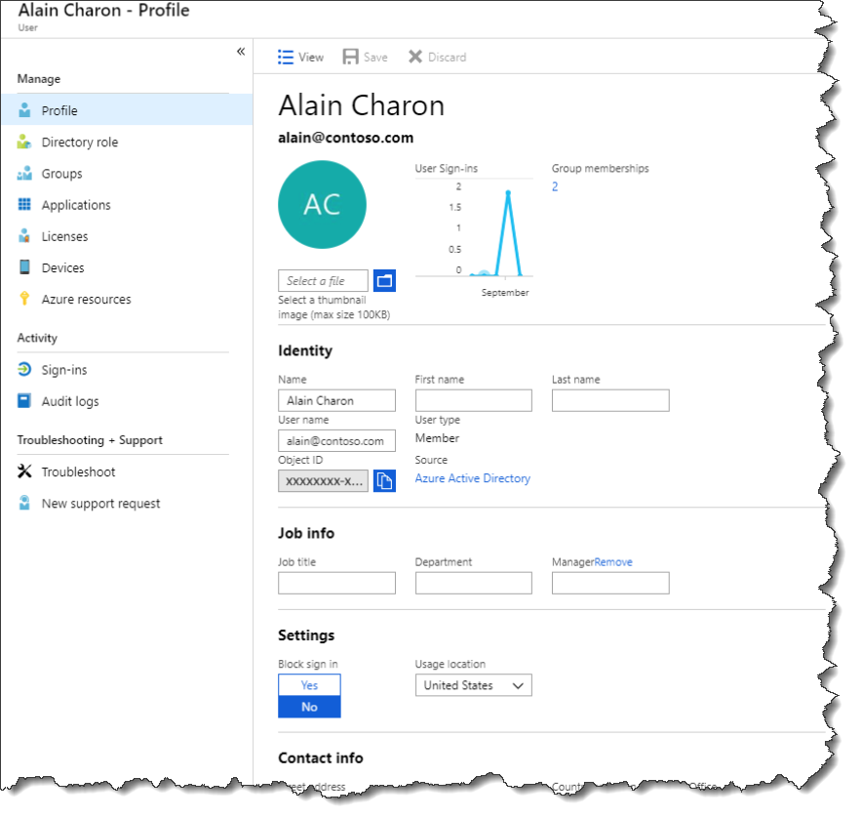
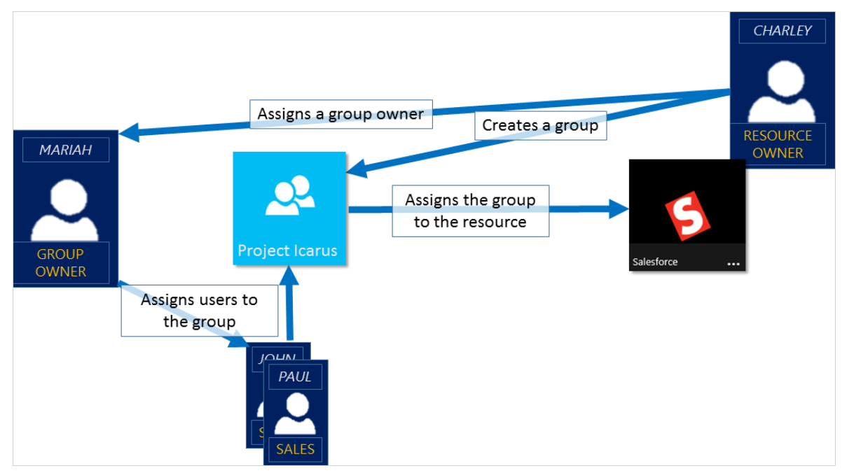
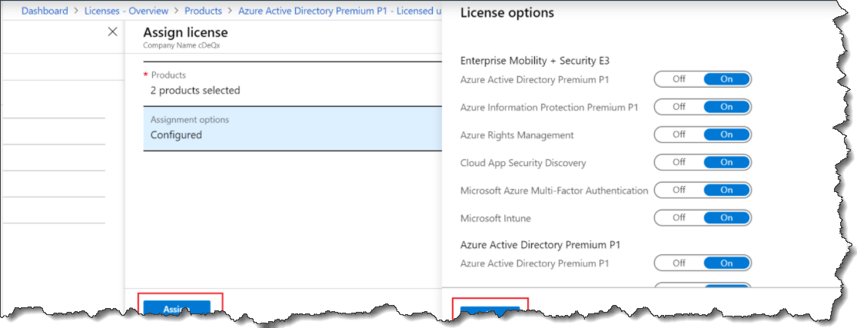
Create, configure, and manage identities
Users
    Create
    Update
    Reset password
    Assign Roles
    Groups
    Create group - add members
    Add - remove group members
    Manage Groups
Licenses
    Assign Remove Licenses
    Group Based Licensing

Slide 13
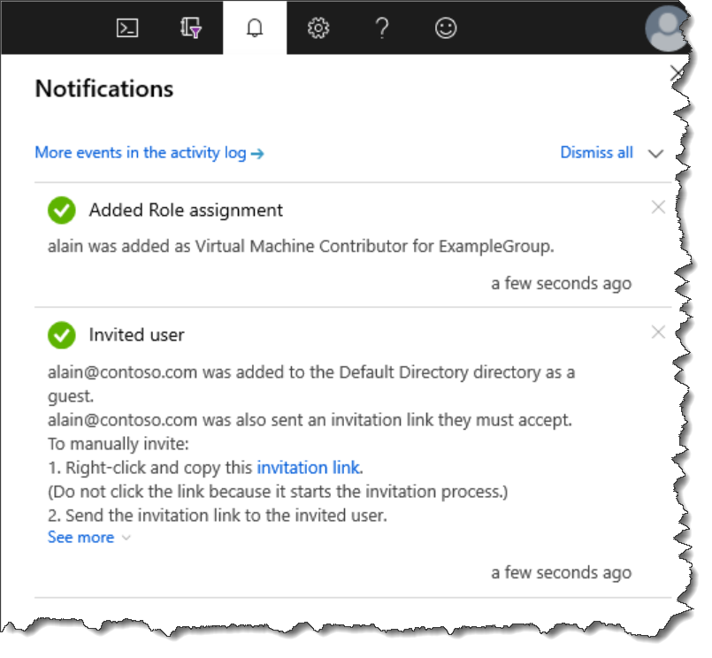
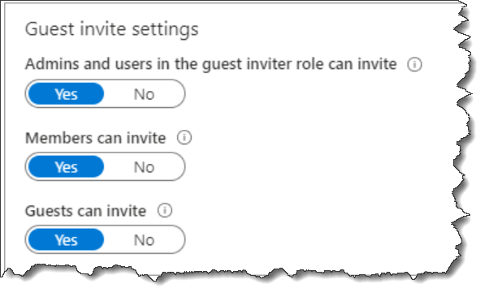
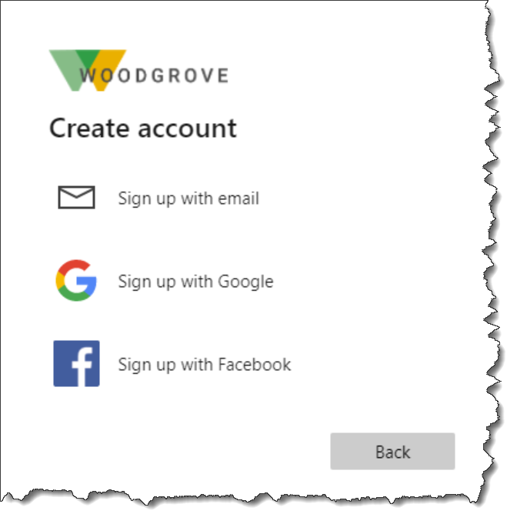
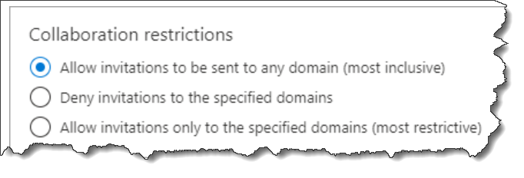
Implement and manage external identities
External Collaboration Settings
    Enable B2B Collaboration
Invite External Users
    Individually PSH / Bulk PSH, Portal
Exernal User Accounts
    Assign Roles in Azure Portal
Identity Providers
    Identity Provider Options

Slide 14
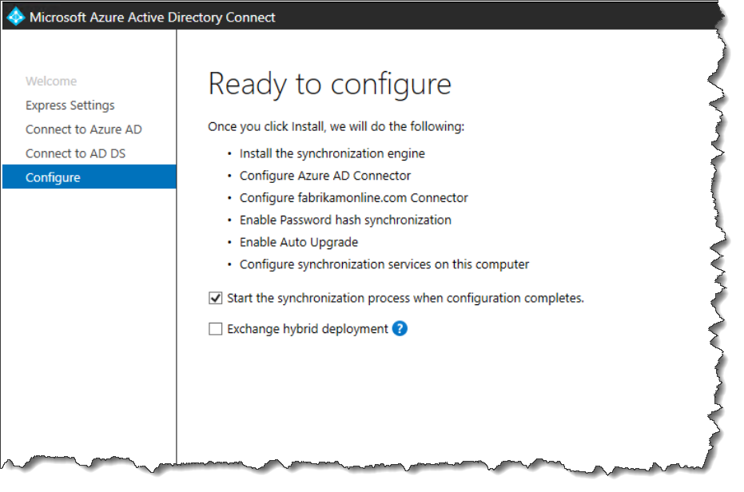
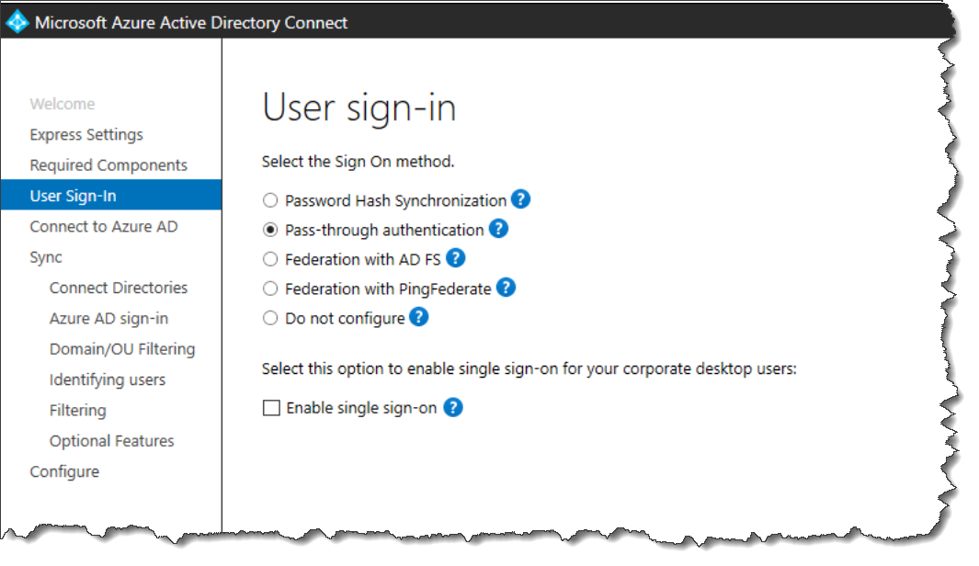
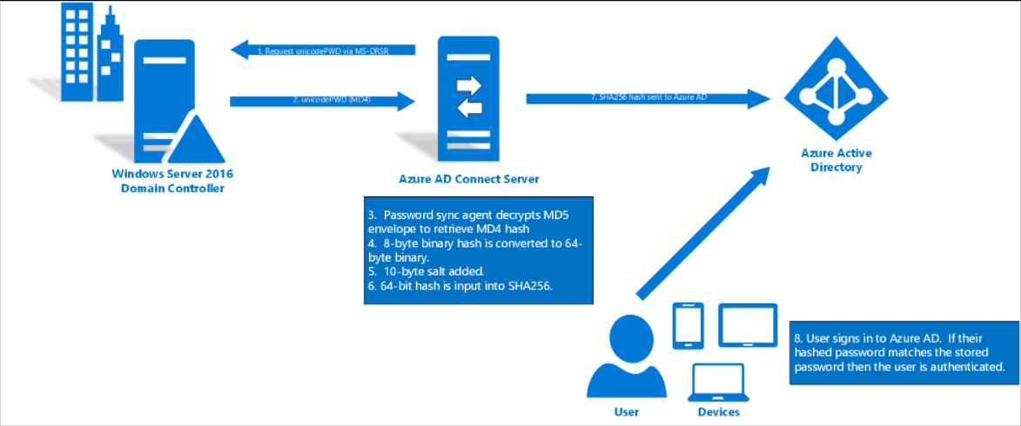
Implement and manage hybrid identity
Azure AD Connect
    Implement, Express or Custom
    Device & Group Writeback
    Prevent Accidental Deletes
Password Hash Sync
    Implement it
    Selective PHS
Pass-Through AuthN
    Deploy PTA + FAQ
Seamless Single Sign-On
    Deploy SSSO + Deep Dive
https://autologon.microsoftazuread-sso.com

Slide 15
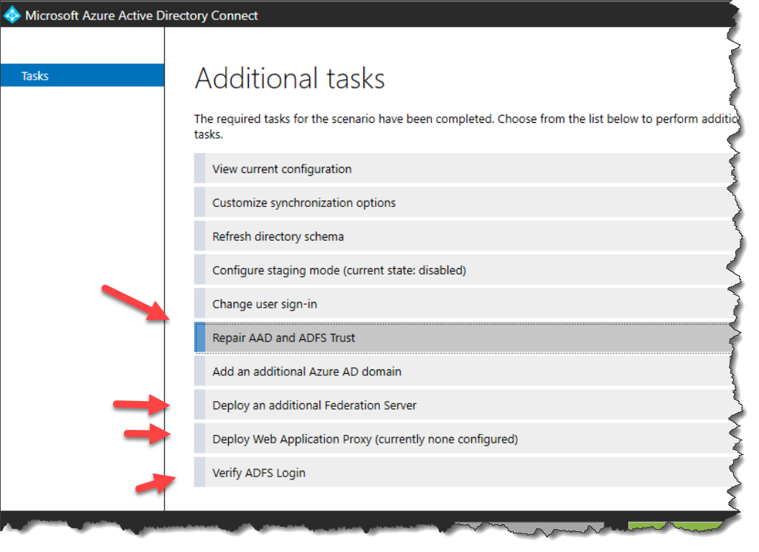
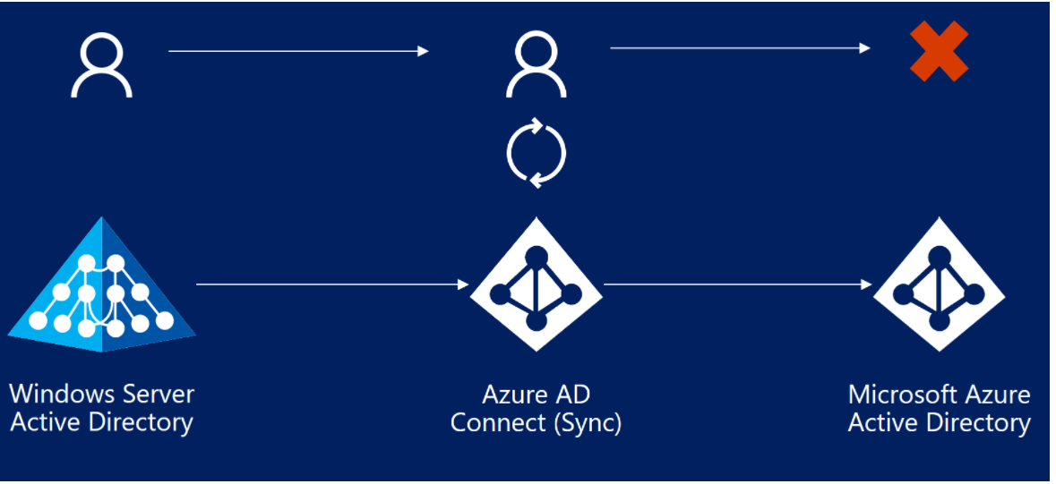
Implement and manage hybrid identity
Federation
    Manage with Azure AD Connect
Azure AD Connect Health
    Operations
    AD FS, Sync, AD DS,
Troubleshoot Synchronization
    Errors

Slide 16
Implement an Authentication and Access Management solution
25-30%

Slide 17
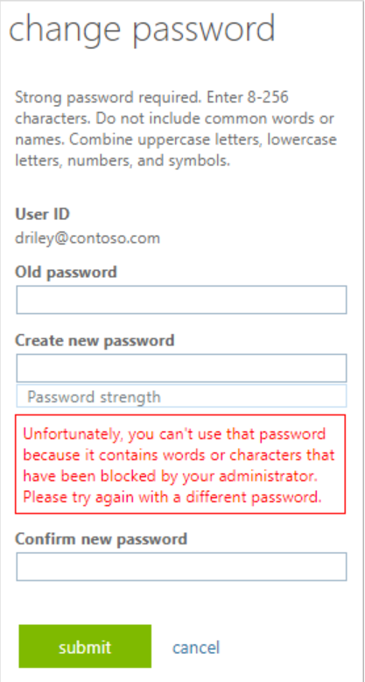
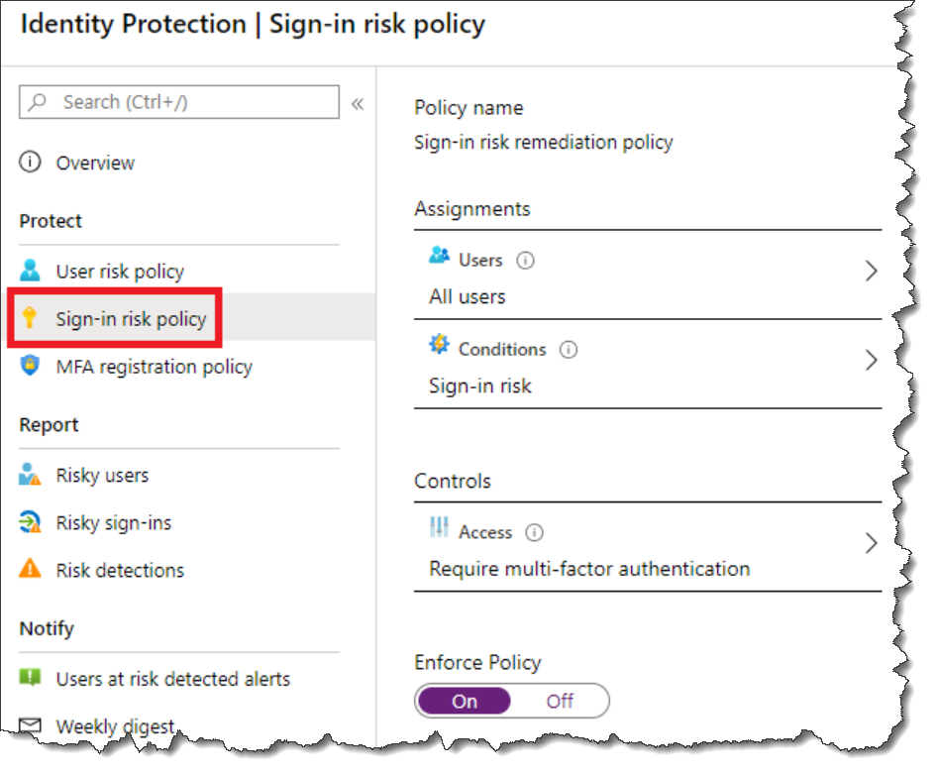
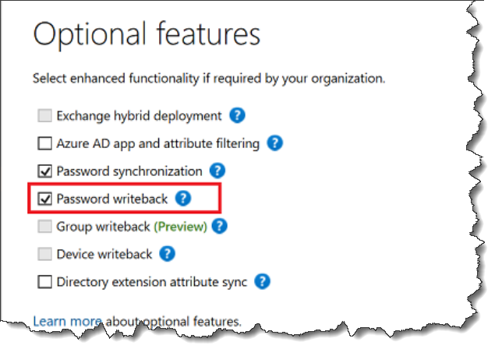
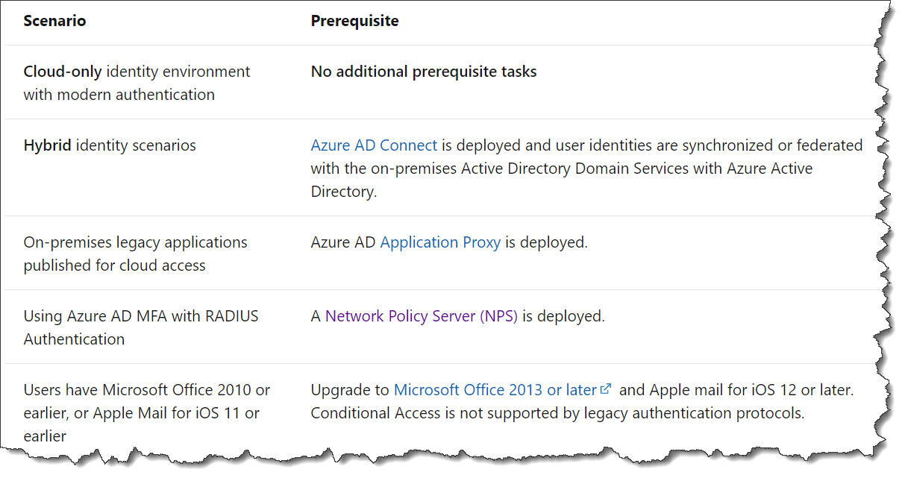
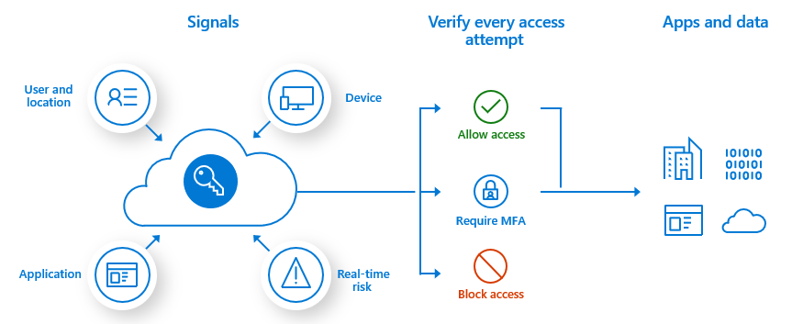
Plan and implement Azure MFA
Azure MFA deployment (excluding MFA Server)
    Plan MFA Deployment
Azure MFA settings
    Enable Azure MFA
Manage Settings
    Writeback
    Banned passwords
    Risk Detections

Slide 18
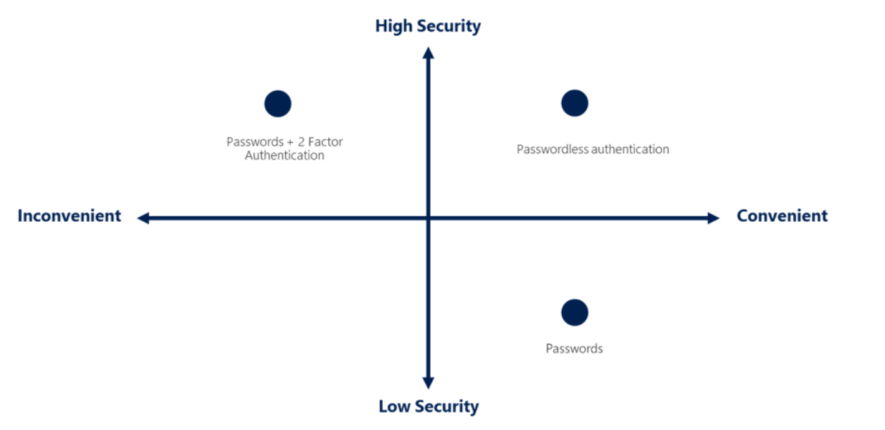
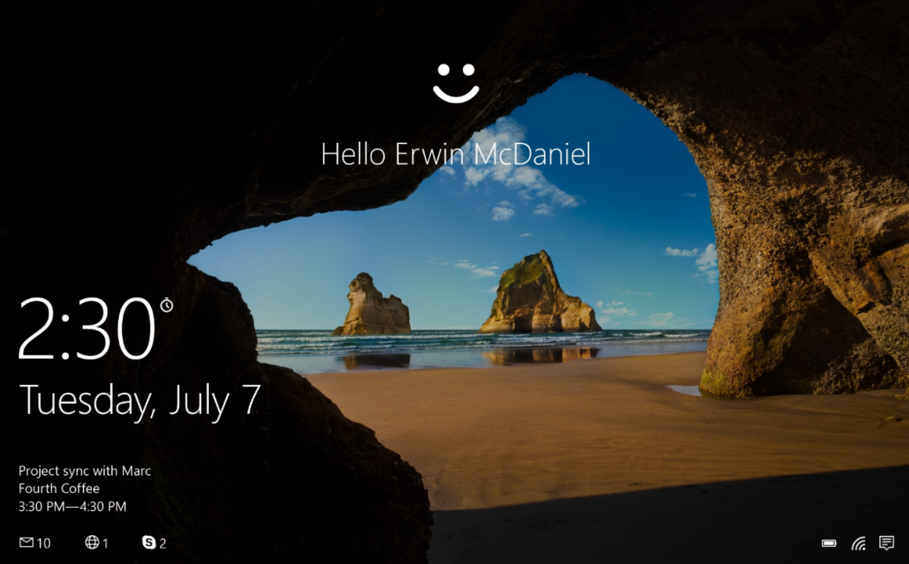
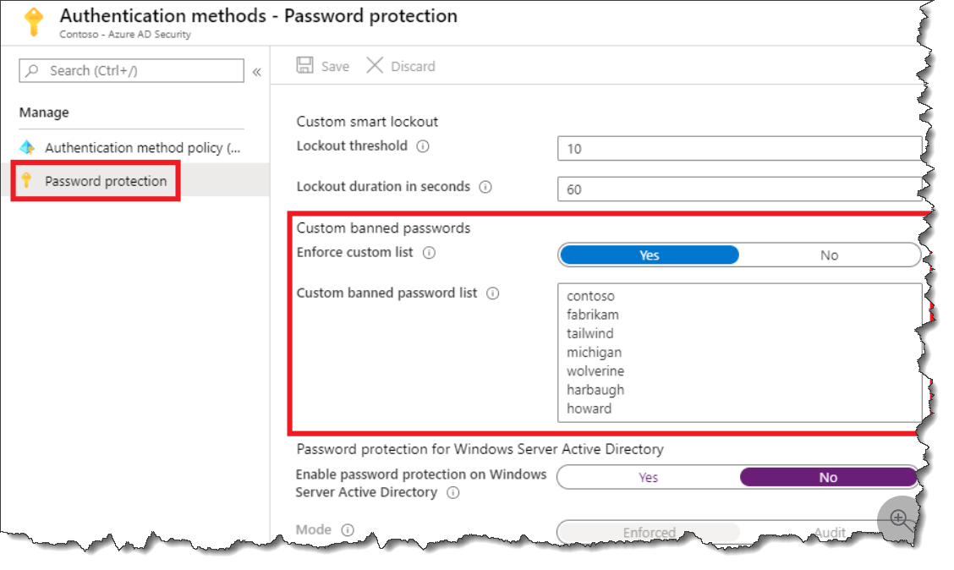
Manage User Authentication
Authentication Methods (FIDO2, passwordless)
    Methods Available
Windows Hello 4 Business
Self Service pw Reset
    Deploy + Configure
Password Protection
    Configure Bad passwords
    Tenant Restrictions
    Azure AD Restrictions

Slide 19
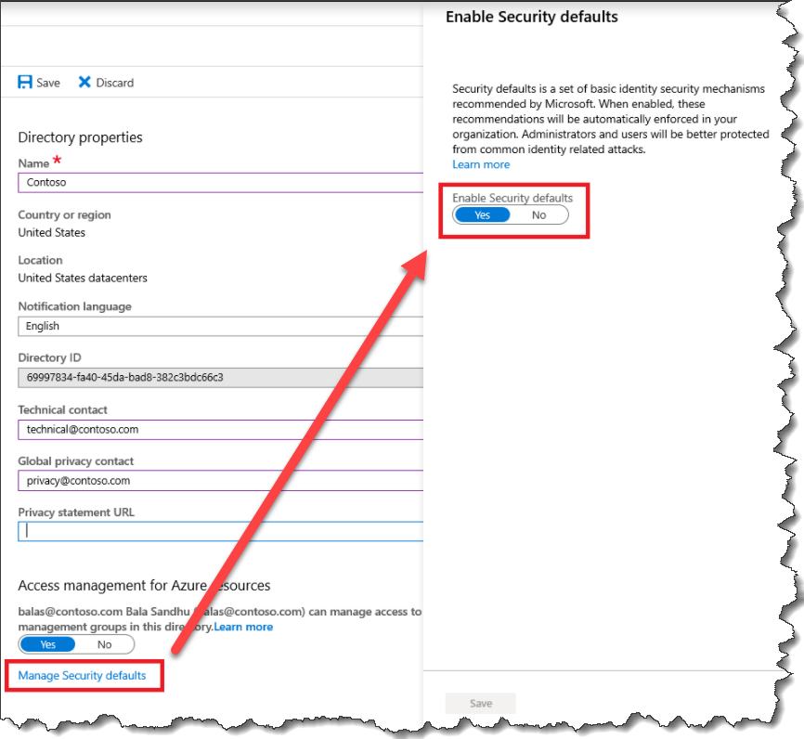
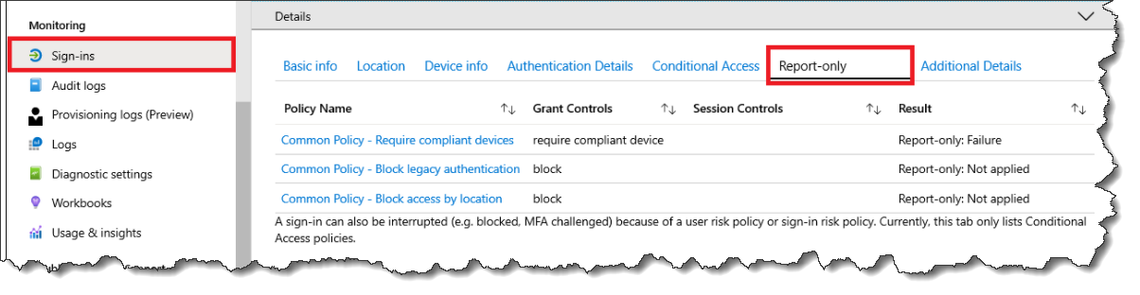
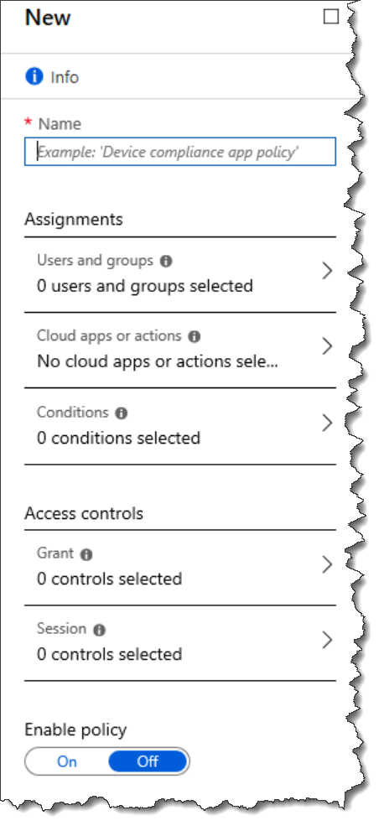
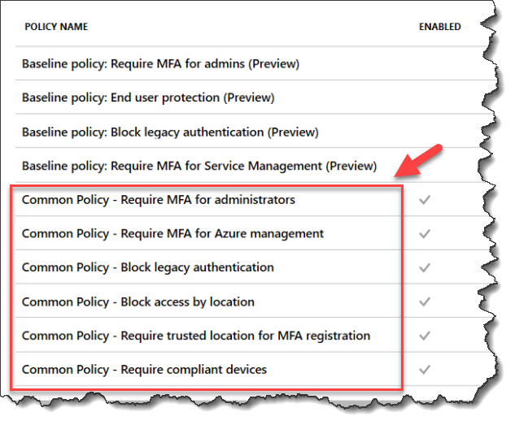
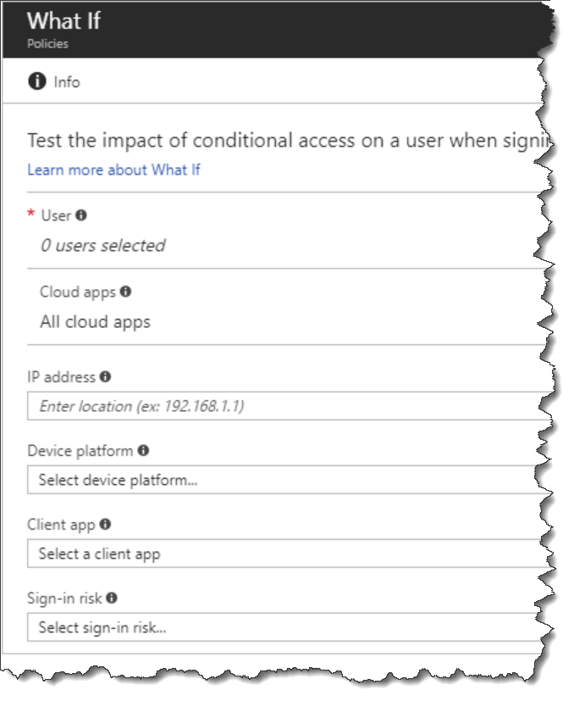
Plan, implement, & administer conditional access
Security Defaults
    Overview
    Alex Weinert’s Blog
Policies
    Common Policies
Implement
    Controls + Assignments
    Test & Troubleshoot
    Report Only Mode
    What if Tool
    Sign-in Problems
Requiring all users to register for Azure AD Multi-Factor Authentication.
Requiring administrators to perform multi-factor authentication.
Blocking legacy authentication protocols.
Requiring users to perform multi-factor authentication when necessary.
Protecting privileged activities like access to the Azure portal.

Slide 20
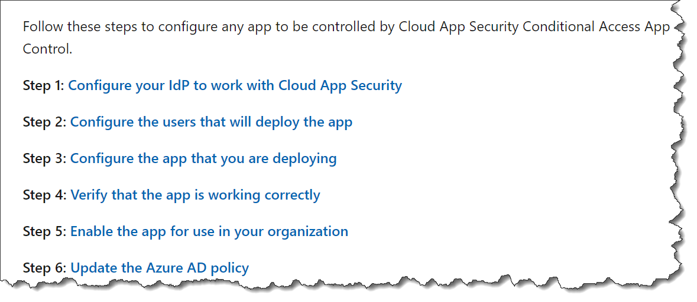
Plan, implement, & administer conditional access
Application Controls
    Require App Protection Policy
    M365 Apps
    Browser Apps
    EXO & SPO
    Deploy App Control for any app
Session Management
    Session Controls
    How session controls work
Smart Lockout
    Azure AD Smart Lockout

Slide 21
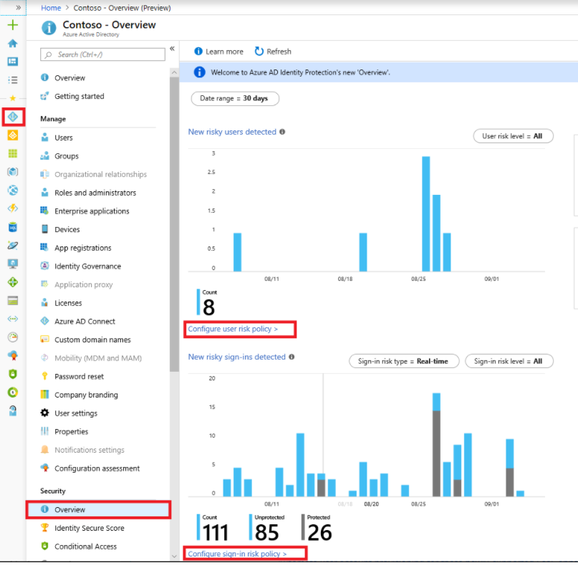

Manage Azure AD Identity Protection
User Risk Policy
Sign-in Risk Policy
    Configure & Enable
MFA Registration Policy
    Configure it
    Elevated Risky Users
    Investigate
    Remediate
What is Azure Active Directory Identity Protection?

Slide 22
Implement Access Management for Apps
10-15%

Slide 23


Plan, implement, and monitor the integration of Enterprise Apps for Single Sign-On (SSO)
Consent Settings
    Implement & Configure
Discover Apps
    MCAS or AD FS app report
Design & Implement
    Access Management
    App Management Roles
    Monitor & Audit
    Token Customizations
Integrating Azure Active Directory with apps
Five steps for integrating all your apps with Azure AD

Slide 24




Plan, implement, and monitor the integration of Enterprise Apps for Single Sign-On (SSO)
Azure AD App Proxy
    Integrate on-premises apps
    Tutorial Walk though
SaaS Apps
    Integrate Custom apps for SSO
    Configure gallery apps
Implement
    App user provisioning
    App registrations
    SaaS and SCIM

Slide 25



Implement App Registrations
Business Application Registration
    Plan the Strategy
    Implement app Registrations
Permissions
    Configure app Permissions
    Implement app Authorization
    Authorization Decisions
Multi-tier Apps
    Plan & Configure permissions
Application Registration & service principals

Slide 26
Plan and Implement an Identity Governance Strategy
25-30%

Slide 27

Plan and implement entitlement management
Catalogs
Access Packages
Entitlements
Terms of Use (TOU)
Lifecycle
Entitlements
TOU
What is entitlement management

Slide 28



Plan, implement, and manage access reviews
Get Started
    Plan When to Use
    Create
Monitor and Manage
    Access Review Findings
    Access Review Licenses
Automate
    Management Tasks
Configure
    Recurring access reviews

Slide 29



Plan and implement privileged access
Strategy
    For Administrative Users’ Access
    Secure access practices for administrators
Configure
    For AD Roles
    For Azure RBAC
    Assign
Manage
    PIM requests
    Audit History & Reports
    Break Glass Accounts
Best practices for Azure AD roleDocs

Slide 30


Monitor and maintain Azure Active Directory
Troubleshoot
    Analyze and Investigate Path
    Sign-in diagnostics
Logging
    Log Analytics
    Azure Monitor
    Sentinel (no KQL!)
    3rd Party
Azure AD
    Workbooks
    Reporting

Slide 31
THANK YOU

