Slide 1
SC-200 C.E.R.T
Microsoft Security Operations Analyst
David Branscome
MCSE since NT 4.0
(Novell before that ☺ )
https://aka.ms/SC-200
https://aka.ms/YouTube/SC-300

Slide 2
Session objectives and takeaways
At the end of this session, you should be
better able to…
  Understand the exam objectives
  Learn some tips and tricks to augment your learning
  Learn some real-world stuff too!
https://aka.ms/SC-200

Slide 3
Using this Deck to Study…
https://aka.ms/SC-600Slides
Some slides have multiple animations
They may hide really important content!
To use this deck to study with use in “Slide Show” mode F5*
Then you will see all content AND links will work ☺
The “Click to Zoom” slide next allows you to jump to topics *

Slide 4
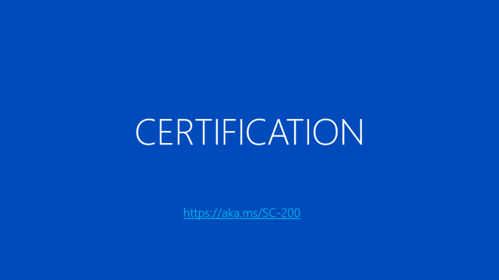
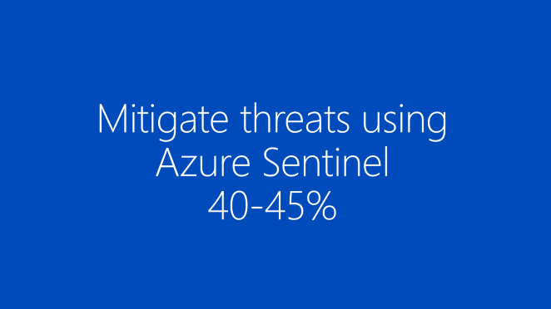
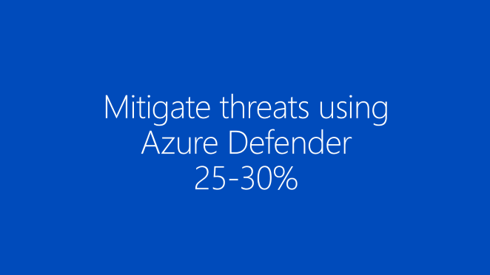
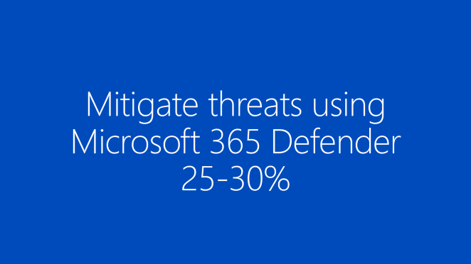
SC-200 Preparation Menu
https://aka.ms/SC-200

Slide 5
CERTIFICATION
https://aka.ms/SC-200

Slide 6


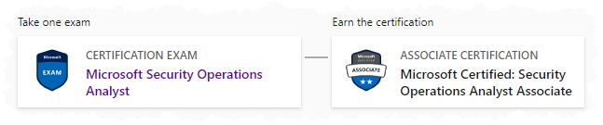
Related Certification
Security Operations Analyst Associate
SC-200 Study Guide Charbel Nemnom, MVP
Skills Measured
    Mitigate threats using Microsoft 365 Defender
    Mitigate threats using Azure Defender
    Mitigate threats using Azure Sentinel
https://aka.ms/SC-200StudyGuide *

Slide 7
How to prepare for the exam…
Know the exam objectives!
Study the Microsoft documentation related to the exam objectives
If there are practice exams, take one...maybe soon!
Get hands-on, if possible
Learning Paths for SC-300
    SC-200 part 1: Mitigate threats using Microsoft Defender for Endpoint
    SC-200 part 2: Mitigate threats using Microsoft 365 Defender
    SC-200 part 3: Mitigate threats using Azure Defender
    SC-200 part 4: Create queries for Azure Sentinel using Kusto Query Language (KQL)
    SC-200 part 5: Configure your Azure Sentinel environment
https://aka.ms/SC-200StudyGuide *

Slide 8

Other places to look for help
If you need more depth training, try the Ninja training for Microsoft Defender and Azure Sentinel
Become a Microsoft 365 Defender Ninja
Become a Microsoft Defender for Endpoint Ninja
Become a Microsoft Defender for Identity Ninja
Become a Microsoft Defender for Office 365 Ninja
Become an Azure Sentinel Ninja

Slide 9
Mitigate threats using Microsoft 365 Defender
25-30%

Slide 10

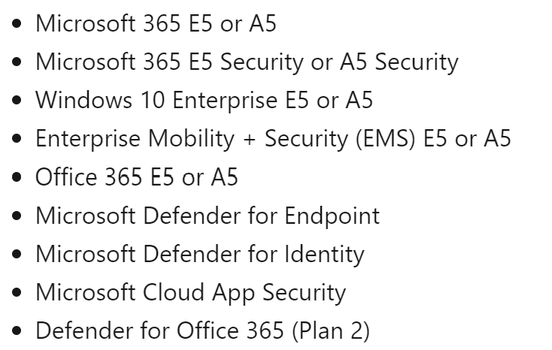
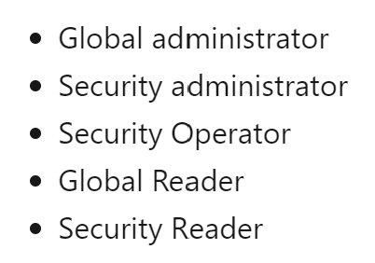
Microsoft 365 Defender
Microsoft 365 Defender is a suite of products that includes:
    Microsoft Defender for Office 365
    Microsoft Defender for Endpoint
    Microsoft Defender for Identity
    Azure AD Identity Protection
    Microsoft Cloud App Security
    Licensing requirements
    Required permissions
  Microsoft 365 Security Center

Slide 11
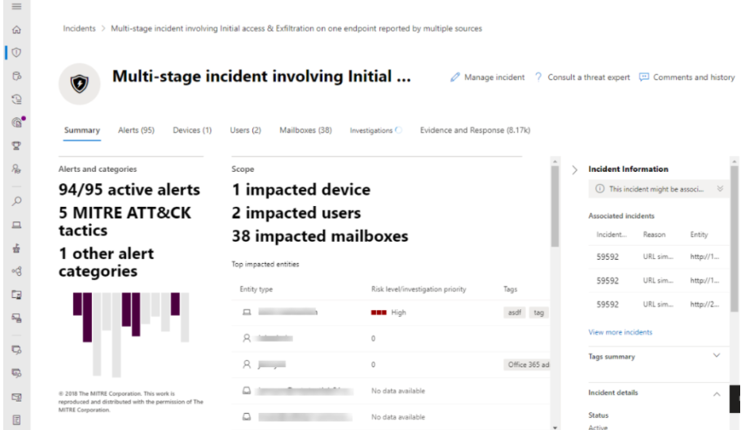
Microsoft 365 Defender
Microsoft 365 Defender can help an organization
    Automatically block attacks and eliminate persistence
    Prioritize incidents for investigation and response
    Workflows and AI provide ability to auto-heal assets
    Focus expertise on cross-domain hunting
Video: Incident Management with Microsoft 365 Defender
Interactive Demo: Protecting Your Organization with Microsoft 365 Defender

Slide 12
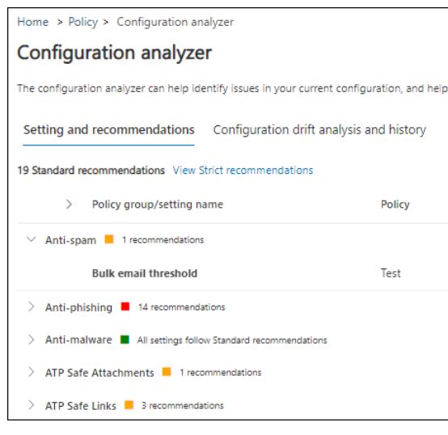

Microsoft Defender for Office 365
Protect Office 365 with:
Threat protection policies:
Safe attachments / Safe links
Anti-phishing protection
Zero-hour auto purge (ZAP)
Preset security policies
Configuration analyzer for security policies
  Safe attachments for Teams, SPO and OD4B
  Application Guard for Office 365

Slide 13
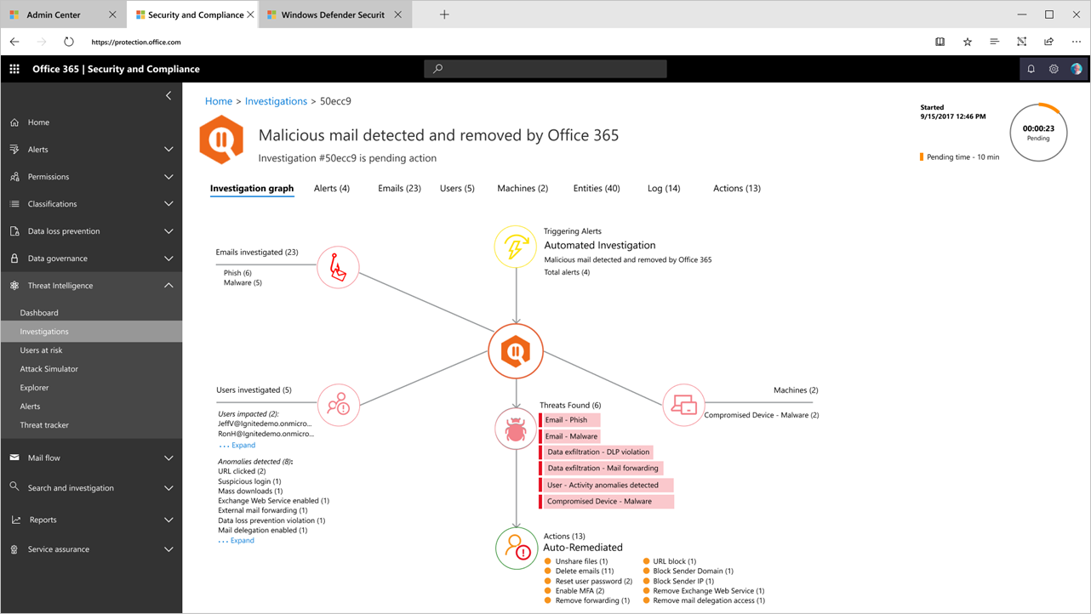
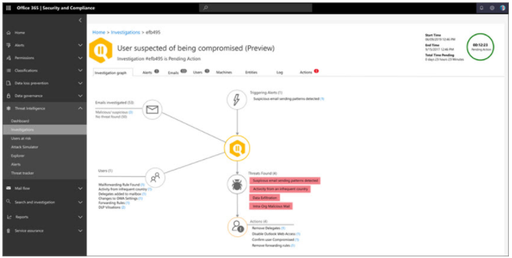
Microsoft Defender for Office 365
Detect, investigate and remediate threats with:
Reports
Threat investigation and response capabilities:
Automated investigation and response capabilities
Understand the results of automated investigations in Microsoft 365
Address compromised user accounts with AIR
Interactive Guide: Safeguard your organization with Microsoft Defender for Office 365

Slide 14
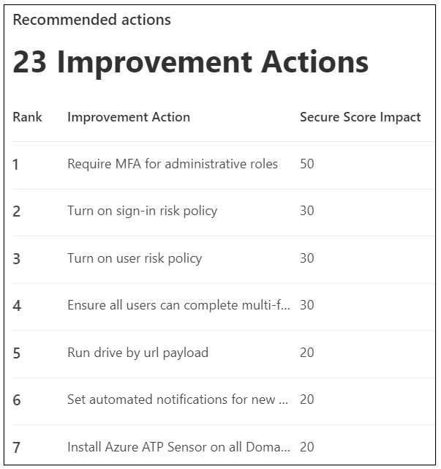
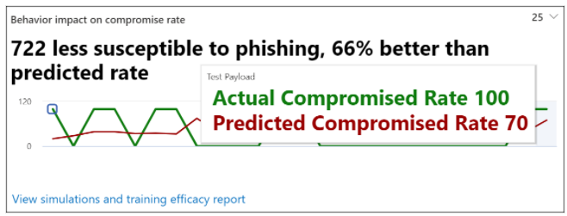
Microsoft Defender for Office 365
Attack Simulation and training
Simulate a phishing attack using Attack Simulation training
Create custom payload for Attack Simulation training
Gain insights through Attack Simulation training
Permissions required:
Organization Management
Security Administrator
or one of the following roles:
Attack Simulator Administrators: Create and managed all aspects of attack simulation campaigns.
Attack Simulator Payload Authors: Create attack payloads that an admin can initiate later.

Slide 15
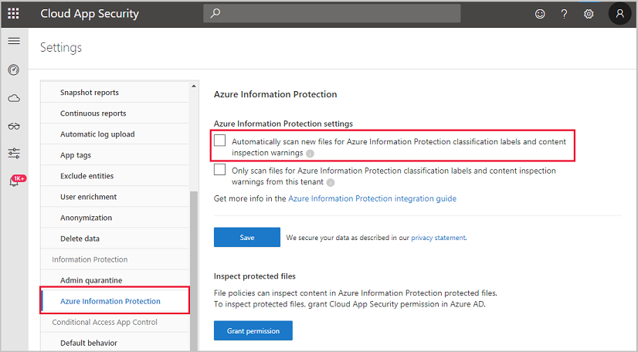
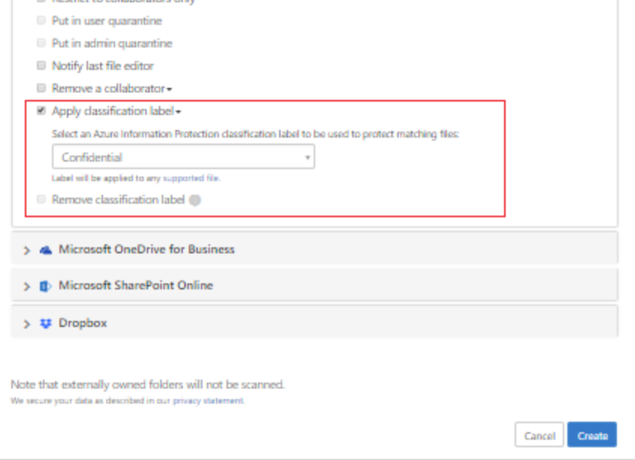
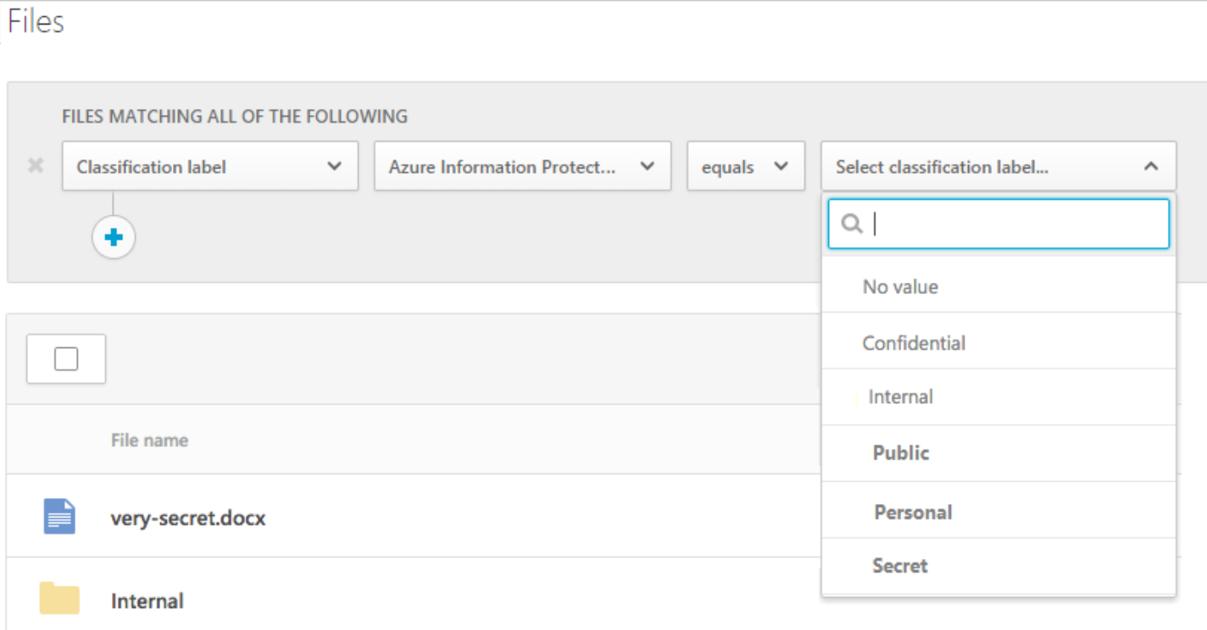
Microsoft Cloud App Security (MCAS)
Managing Data Protection
MCAS Conditional Access App Control
Deploy Cloud App Security Conditional Access App Control for Azure AD Apps
Integrate Azure Information Protection with Cloud App Security
Tutorial: Discover and protect sensitive information in your organization
Integrate Azure Information Protection with Cloud App Security
Video: MCAS Comprehensive video
Video: MCAS + AIP Integrations | Microsoft Security | Channel 9 (msdn.com)
Interactive Demo: Discover, protect and control your apps with Microsoft Cloud App Security
Interactive Demo: Detect threats and manage alerts with MCAS

Slide 16
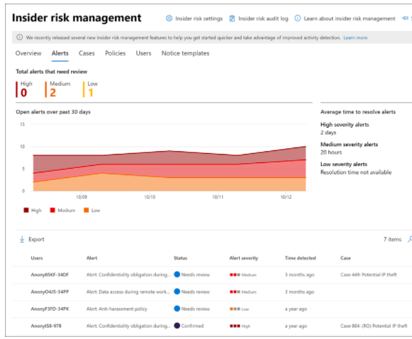
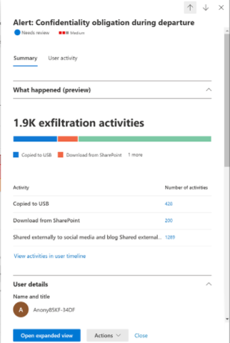
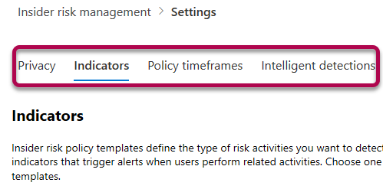
Insider Risk Management
Policy templates
Departing employee theft
Data leaks
Offensive language in email
Policy settings
Privacy and indicators
Policy timeframes
Intelligent detections
Interactive Demo: Minimize internal risks with Insider Risk Management in Microsoft 365

Slide 17
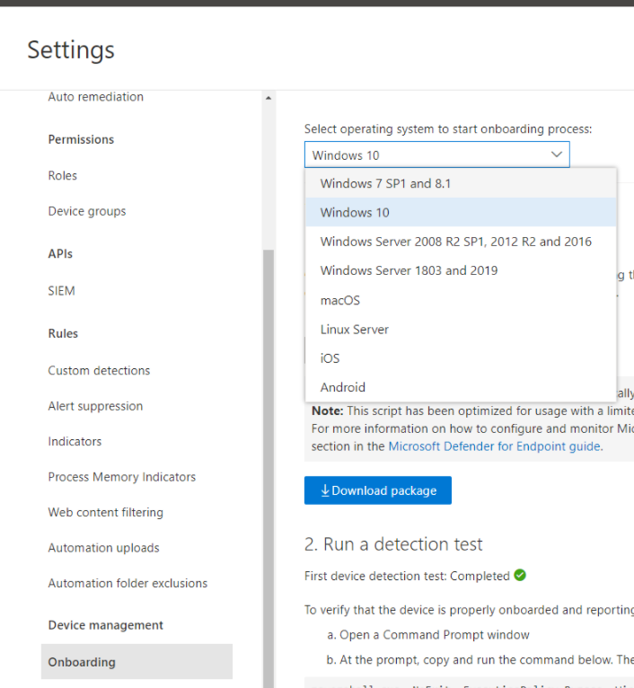
Microsoft Defender for Endpoint
Setting Up Defender for Endpoint
    Licensing requirements
    Supported OS’es
    Administrator Permissions
    Device discovery overview
    Network devices supported
    Create and manage device groups
Video: Microsoft Defender ATP Threat and Vulnerability Mgmt
Interactive guide: Reduce organizational risk with Threat and Vulnerability Management
Video: Threat hunting with Microsoft 365 Defender

Slide 18
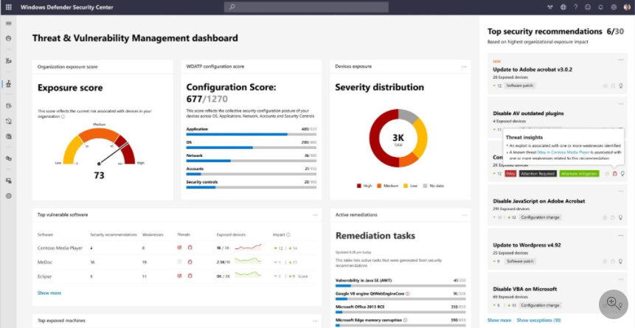
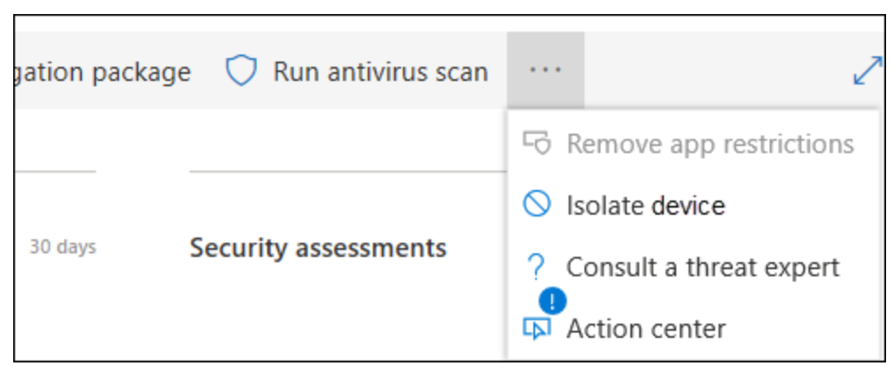
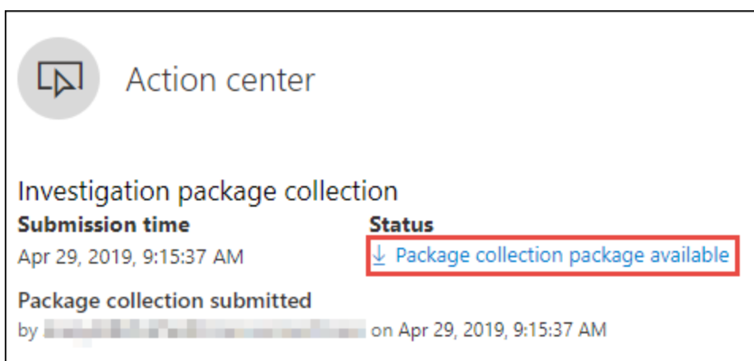
Microsoft Defender for Endpoint
Major capabilities
Threat and Vulnerability Management
Attack Surface Reduction
    Enable ASR rules with PowerShell
Next Gen Protection
Endpoint Detection and Response (EDR)
    Take response actions on a device
Automated investigation and remediation (AIR)
    Automation levels in AIR
Interactive guide: Investigate and remediate threats with Microsoft Defender for Endpoint
YouTube: Microsoft Defender for Endpoint Video Playlist

Slide 19
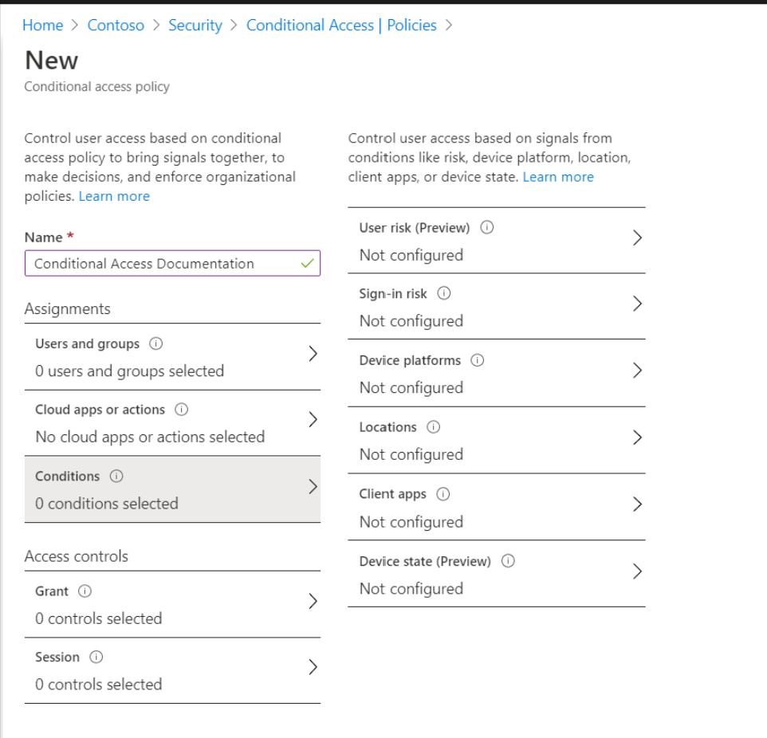
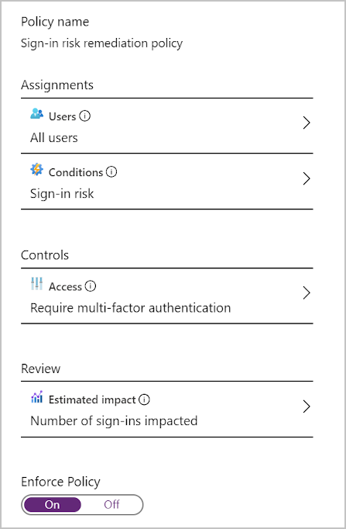
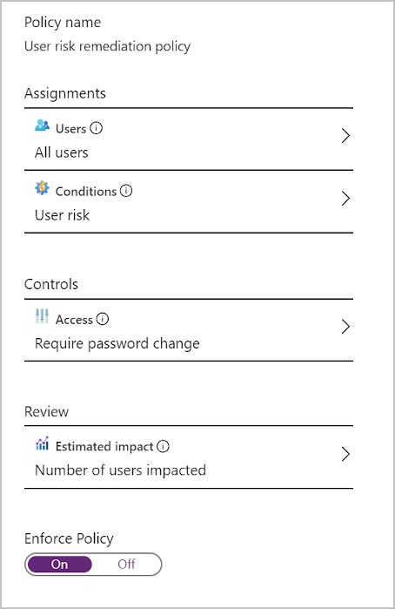
Azure AD Identity Protection
Risk identification
    Azure AD Identity Protection policies
    Configure and enable risk policies
Conditional Access
    Risk as a condition in Conditional Access policy

Slide 20
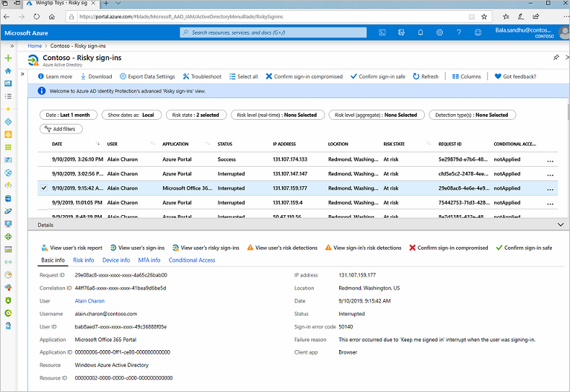
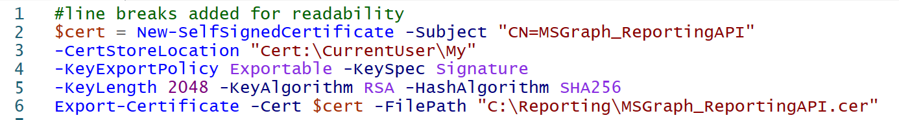
Azure AD Identity Protection
Investigate and remediate identity risk
    Investigate risk with Azure Active Directory Identity Protection
    Remediate risks and unblock users in Azure AD Identity Protection
    Connect to Identity Protection using Microsoft Graph API

Slide 21
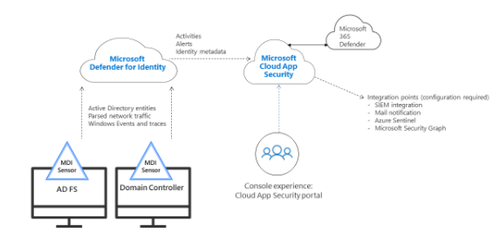
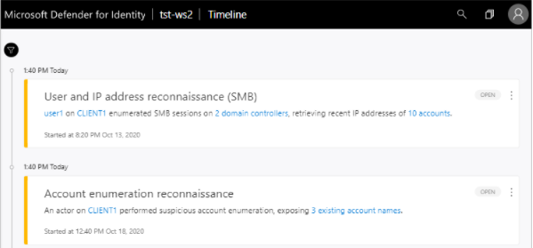
Microsoft Defender for Identity
Defender for Identity
    Microsoft Defender for Identity architecture
    Previously known as Azure ATA
    Microsoft Defender for Identity prerequisites
    Defender for Identity sensor requirements
    Microsoft Defender for Identity integration with MCAS
    Working with security alerts in Microsoft Defender for Identity
Video: Bolster your security posture with Defender for Identity
Video: Incident investigation with Microsoft Defender for identity

Slide 22
Mitigate threats using
Azure Defender
25-30%

Slide 23
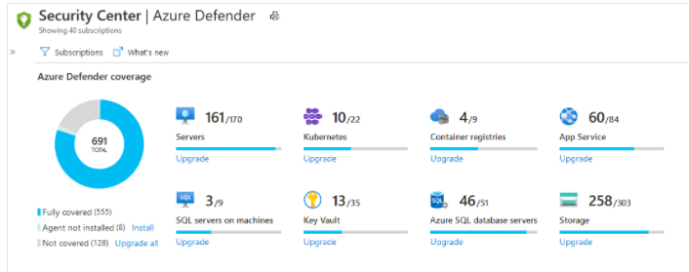
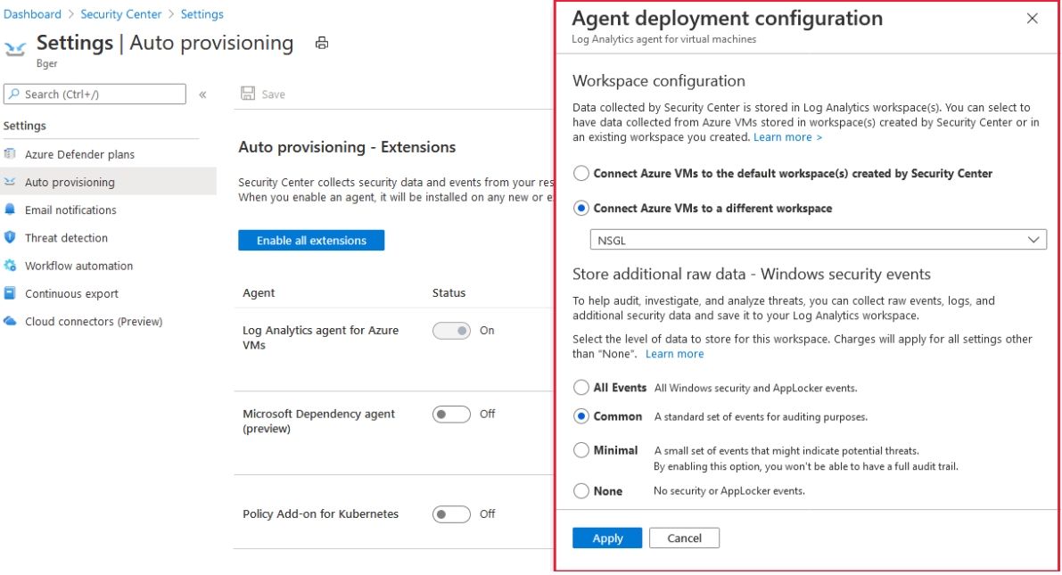
Design and configure an Azure Defender implementation
Azure Defender
Supported platforms
Permissions and allowed actions
Workspace setup
Enabling Azure Defender
Azure Defender for:
...Servers
...SQL
...Containers
...App Service
...Storage
...Key Vault
...Resource Manager
…DNS
Interactive guide: Protect your hybrid cloud with Azure Security Center

Slide 24
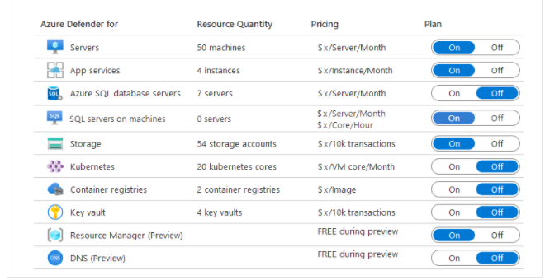
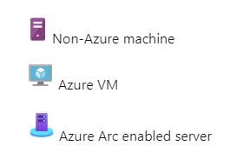
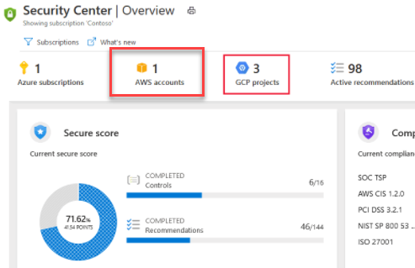
Data Connectors in Azure Defender
Azure Defender configuration
Automated Onboarding for Azure resources
Identify data sources to be ingested for Azure Defender
Connect non-Azure machines to ASC
Connect Azure Stack, Linux and Windows with Azure portal
Connect AWS cloud resources
Connect GCP cloud resources
Connect and integrate data sources

Slide 25
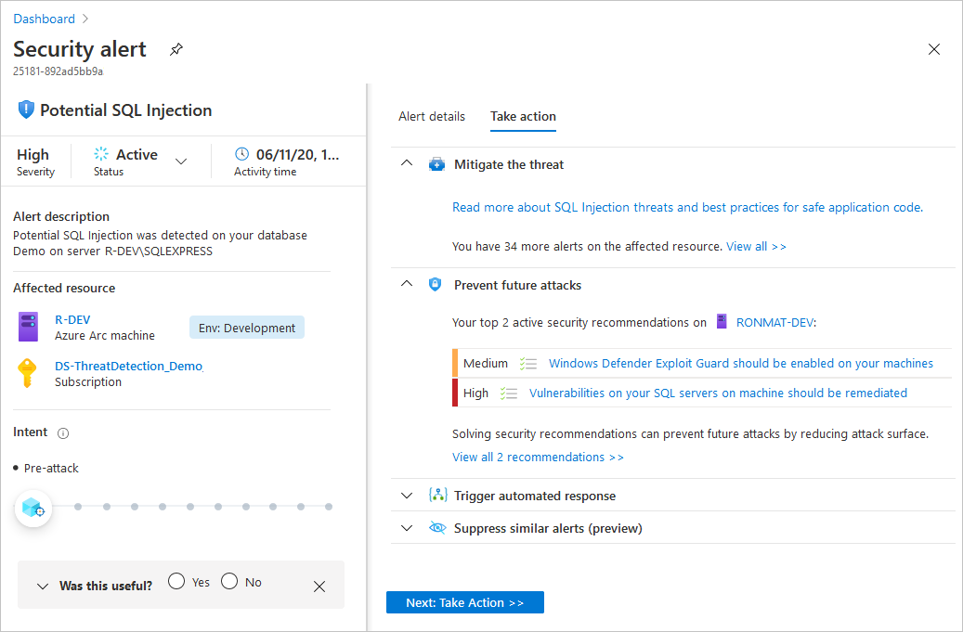
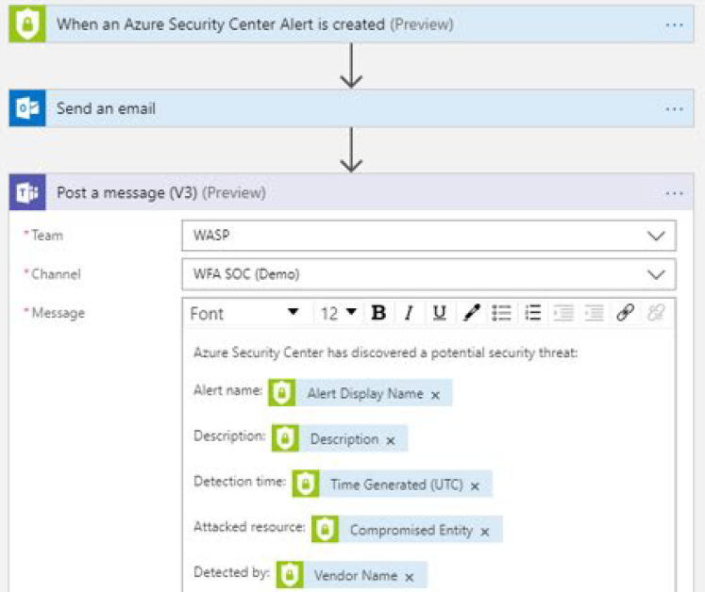
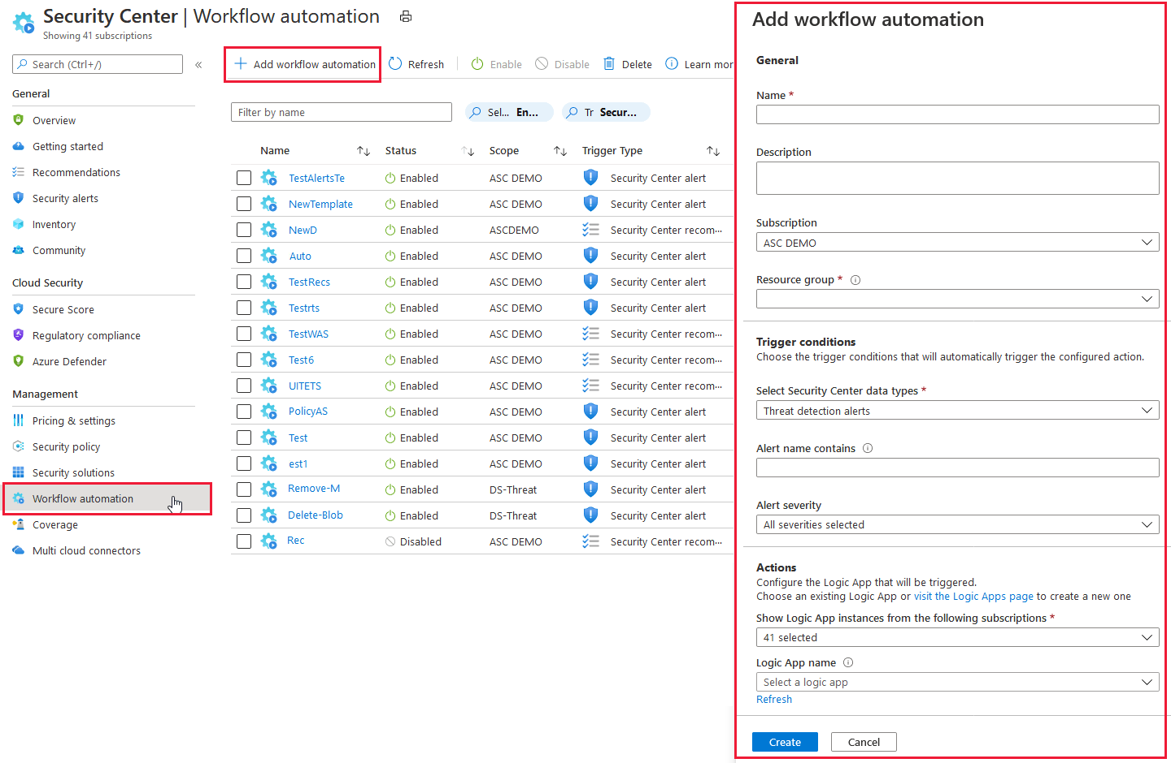
Manage Alerts with Azure Defender
Manage Azure Defender alert rules
Validate alert configuration
Set up email notifications
Create and manage alert suppression rules
Configure automation and remediation
Configure automated responses in Azure Security Center
Remediate incidents by using Azure Defender recommendations
Create an automatic response using an Azure Resource Manager template

Slide 26
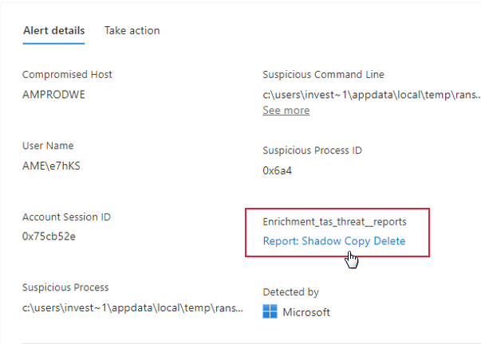
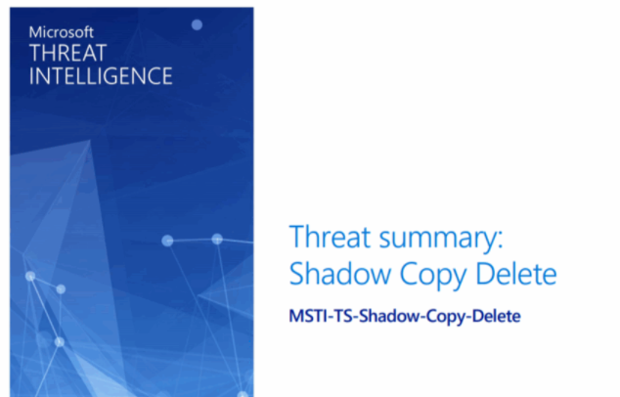
Investigate Alerts with Azure Defender
Investigate Azure Defender alerts and incidents
Describe alert types for Azure workloads
Manage security alerts
Manage security incidents
Analyze Azure Defender threat intelligence
Respond to Azure Defender for Key Vault alerts
Manage user data discovered during an investigation
YouTube Channel: Azure Security Center in the Field
Channel 9: Mitigating Security Issues using Azure Security Center

Slide 27
Mitigate threats using
Azure Sentinel
40-45%

Slide 28

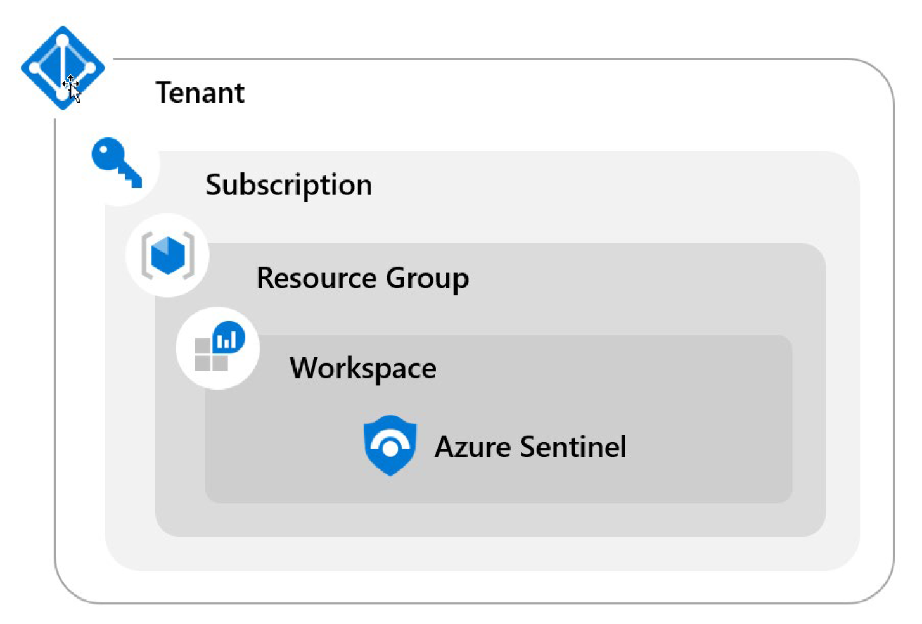
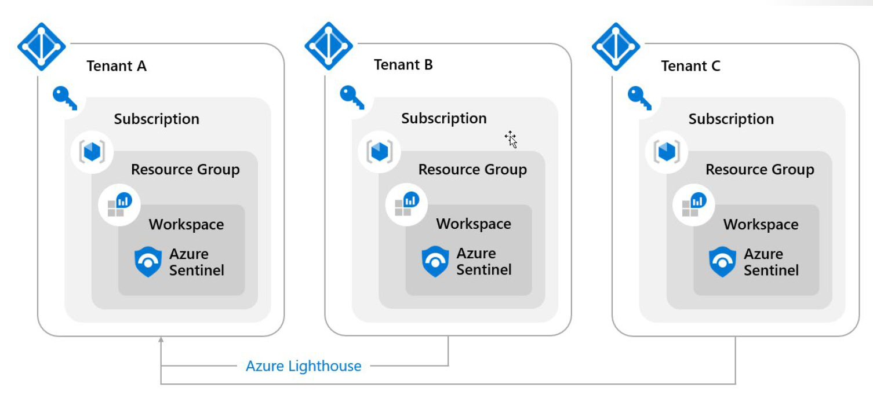
Design and Configure Azure Sentinel
Planning the workspace
Best practices for designing an Azure Sentinel workspace
Extend Azure Sentinel across workspaces and tenants
Configuring Roles
Permissions in Azure Sentinel
Protecting managed security service provider (MSSPs) intellectual property in Azure Sentinel

Slide 29
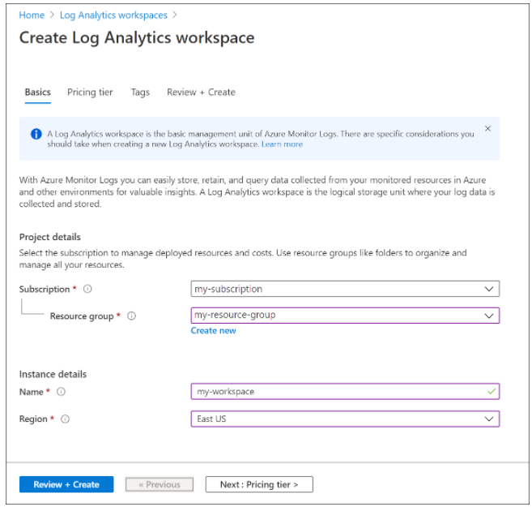
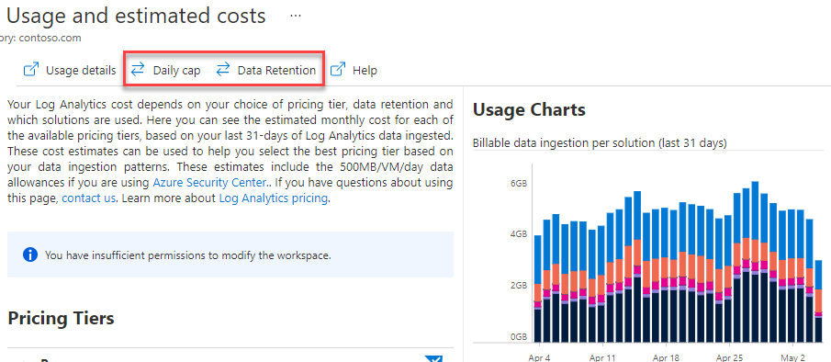
Design and Configure Azure Sentinel
Storage Planning
Create a Log Analytics workspace in the Azure portal
Manage usage and costs for Azure Monitor Logs - Azure Monitor
Service Security
Azure security baseline for Azure Sentinel

Slide 30
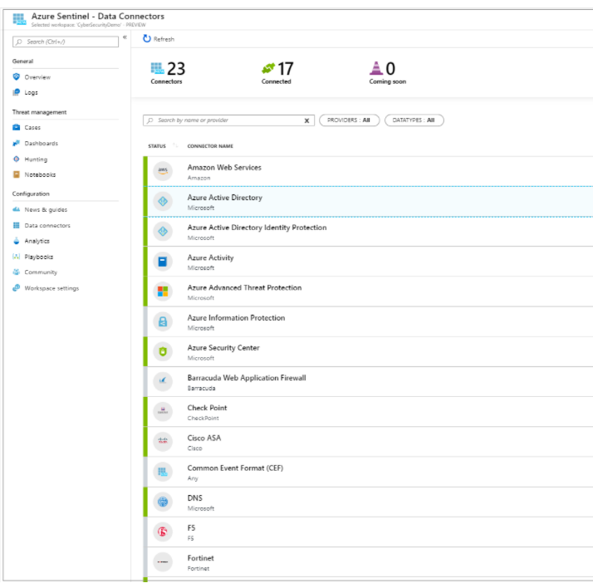
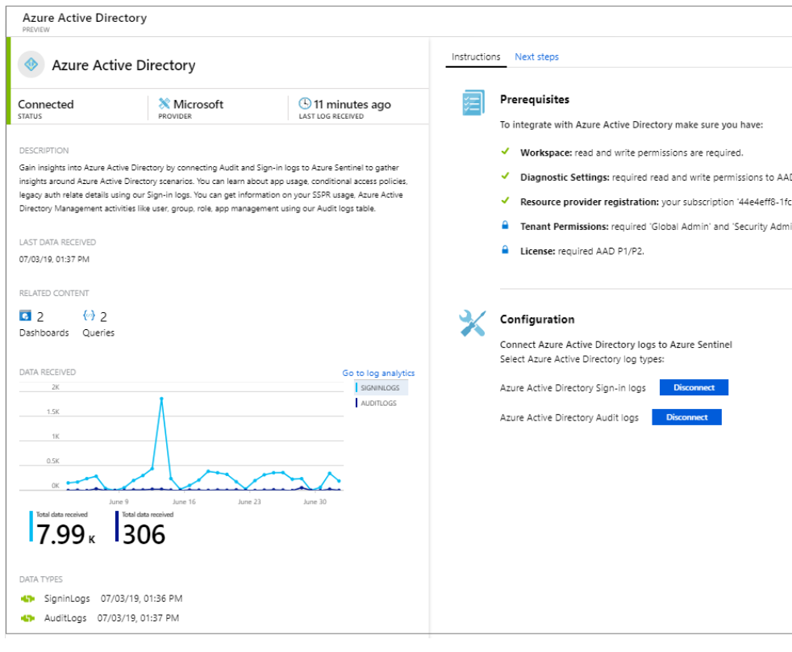
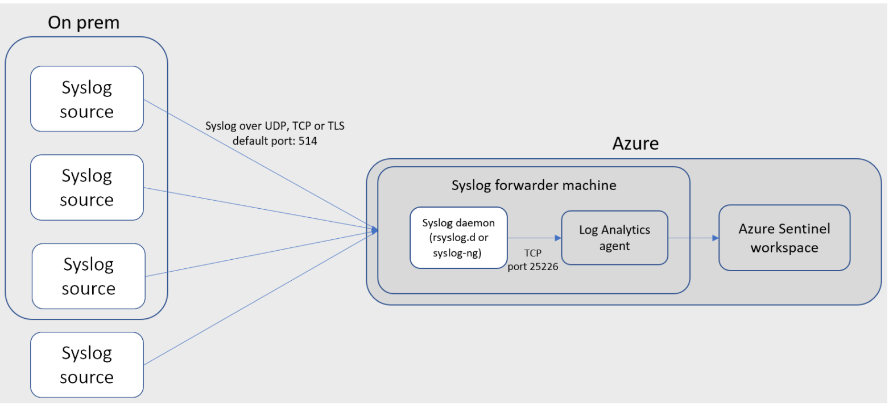
Planning Data Sources for Azure Sentinel
Plan and use data connectors
Configure Syslog and CEF collections
Configure and use the Windows Event collectors

Slide 31
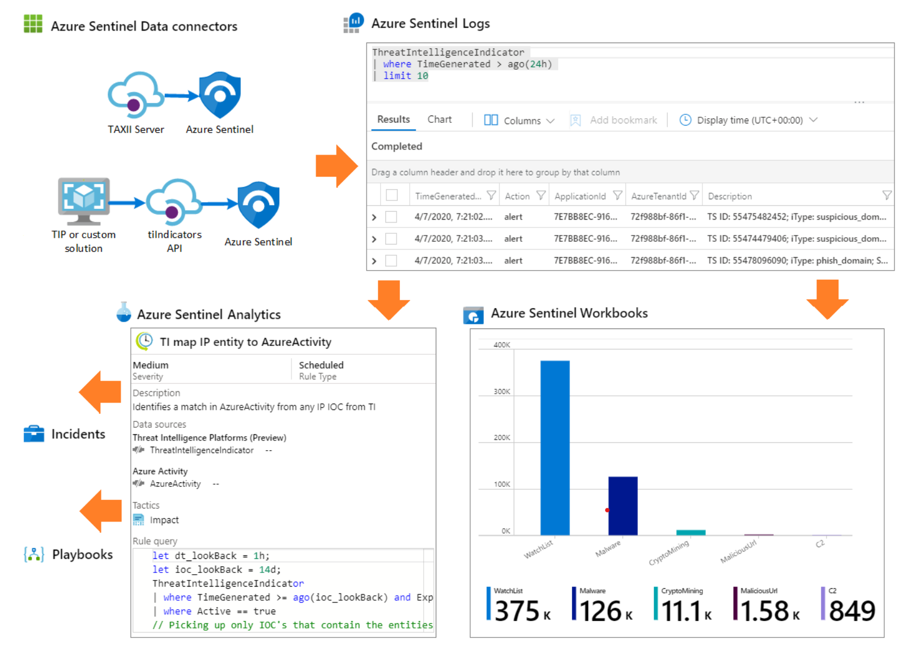
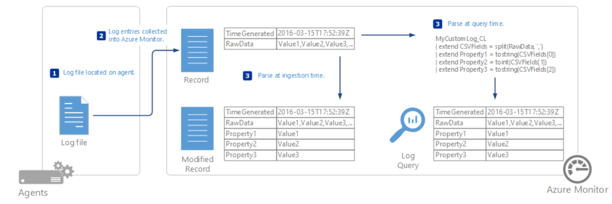
Planning Data Sources for Azure Sentinel
Threat Intelligence Connectors
Create custom logs in Azure Log Analytics

Slide 32
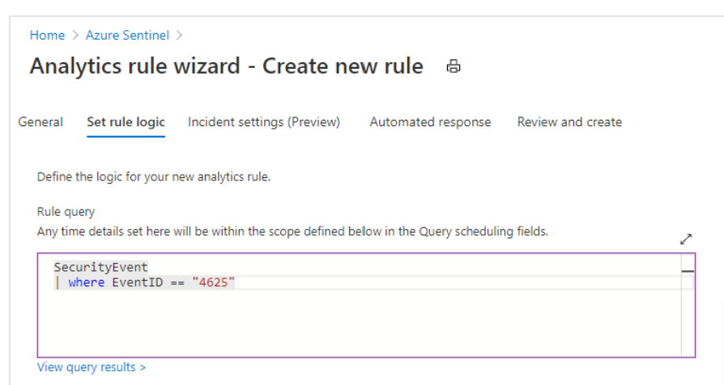

Managing analytic rules in Sentinel
Configuring rules
Configuring queries
Define incident creation logic

Slide 33



Configure SOAR in Azure Sentinel
Create playbooks
Trigger playbooks
Manage incidents with playbooks

Slide 34


Manage Azure Sentinel Incidents
Investigate, triage and respond to incidents
Work with Azure Sentinel incidents in many workspaces at once
Identify advanced threats with UEBA

Slide 35


Using Azure Sentinel Workbooks
Activate and customize workbook templates
Configure advanced visualizations
Using the security operations efficiency workbook

Slide 36



Hunt for threats in the Azure Sentinel portal
Create custom hunting queries
Run hunting queries manually
Monitor queries using Livestream
Track queries with bookmarks
Convert a query to an analytic rule

Slide 37
THANK YOU!

